Slide 1
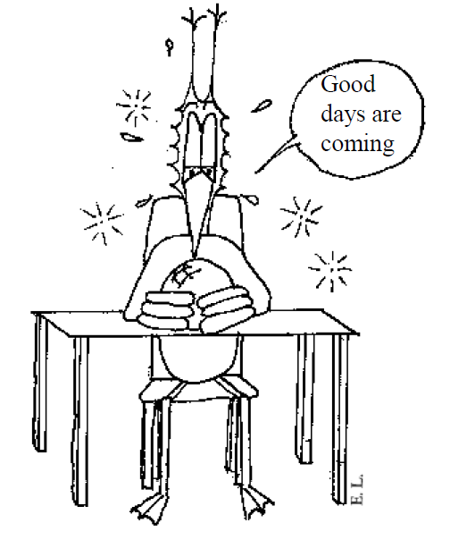
Forecasting Part 2
Jean-Yves Le Boudec 2021

Slide 2
Contents
Linear Time Series Methods
Differencing Filters
Filters for dummies
Prediction with filters
ARMA Models
Other methods

Slide 3
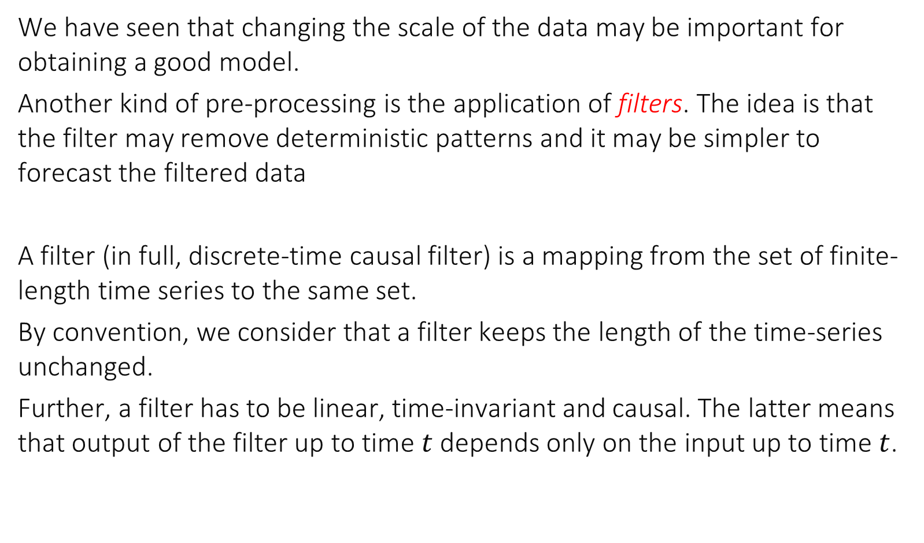
6. Differencing the Data
We have seen that changing the scale of the data may be important for obtaining a good model.
Another kind of pre-processing is the application of filters. The idea is that the filter may remove deterministic patterns and it may be simpler to forecast the filtered data
A filter (in full, discrete-time causal filter) is a mapping from the set of finite-length time series to the same set.
By convention, we consider that a filter keeps the length of the time-series unchanged.
Further, a filter has to be linear, time-invariant and causal. The latter means that output of the filter up to time $t$ depends only on the input up to time $t$.

Slide 4
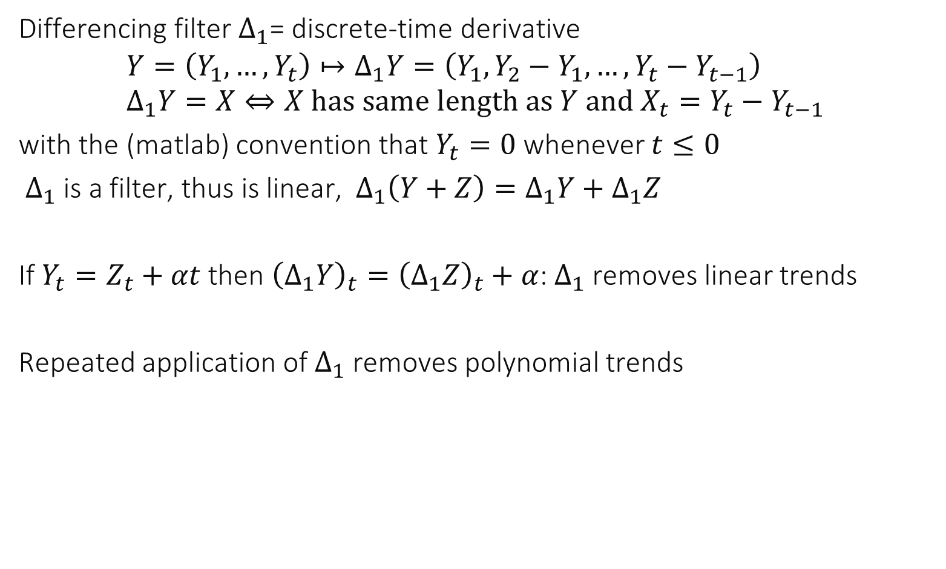

Differencing filter $Δ_{1}$
Differencing filter $Δ_{1}$= discrete-time derivative
$$Y=\left(Y_{1},…,Y_{t}\right)↦Δ_{1}Y=\left(Y_{1},Y_{2}−Y_{1}, …,Y_{t}−Y_{t−1}\right) \\ Δ_{1}Y=X⇔X has same length as Y and X_{t}=Y_{t}−Y_{t−1 }$$ with the (matlab) convention that $Y_{t}=0$ whenever $t≤0$
$Δ_{1}$ is a filter, thus is linear, $Δ_{1}\left(Y+Z\right)=Δ_{1}Y+Δ_{1}Z$
If $Y_{t}=Z_{t}+αt$ then ${\left(Δ_{1}Y\right)}_{t}={\left(Δ_{1}Z\right)}_{t}+α$: $Δ_{1}$ removes linear trends
Repeated application of $Δ_{1}$ removes polynomial trends

Slide 5
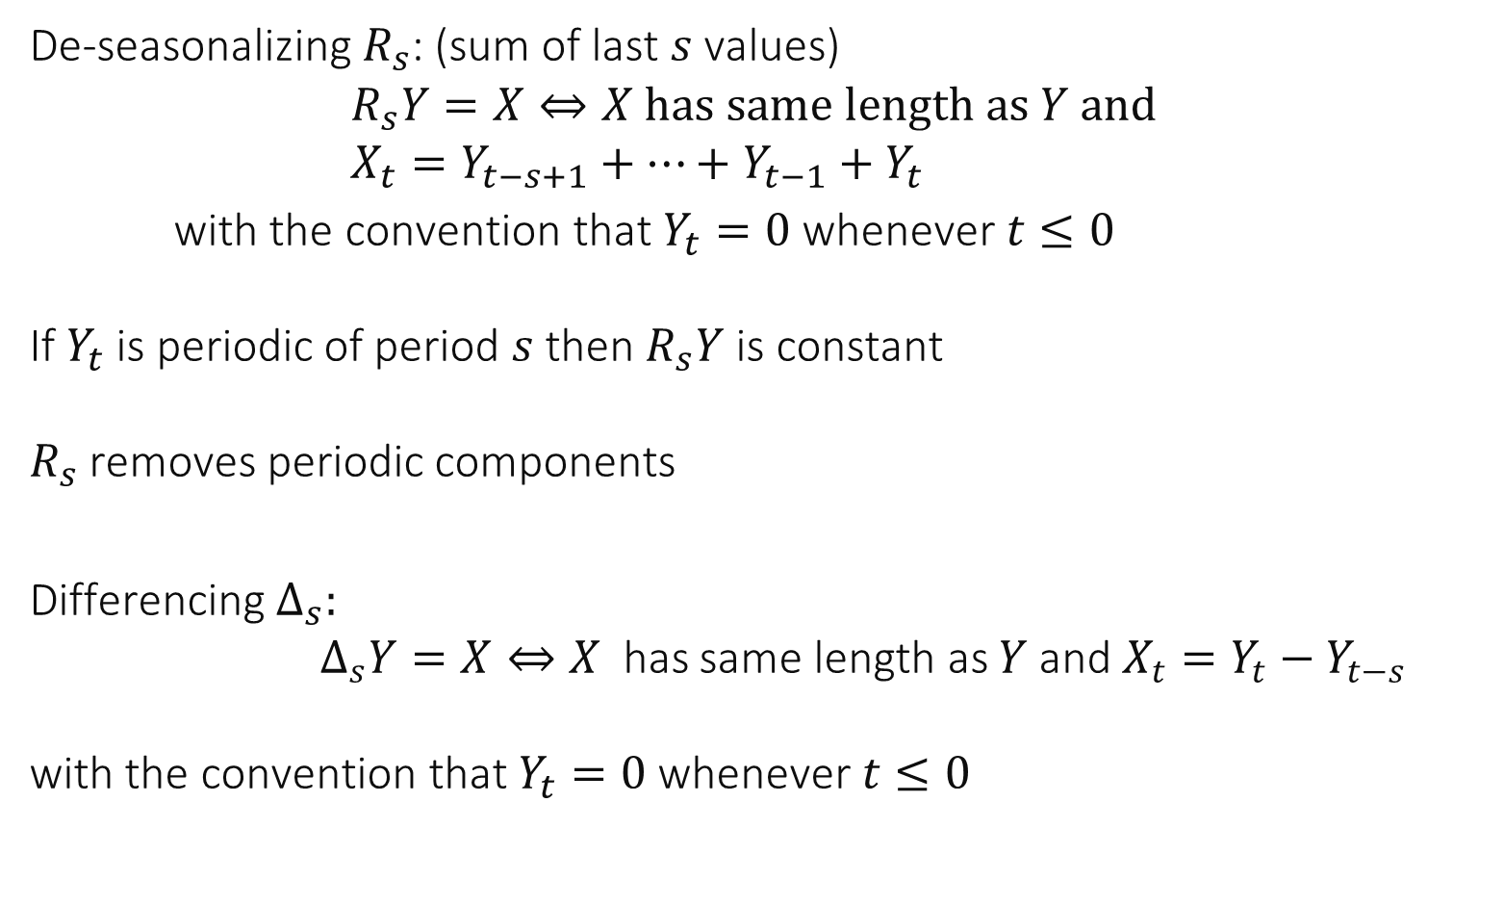
De-seasonalizing filters
De-seasonalizing $R_{s}$: (sum of last $s$ values)
$$R_{s}Y=X⇔X has same length as Y and \\ X_{t}=Y_{t−s+1}+…+Y_{t−1}+Y_{t}$$ with the convention that $Y_{t}=0$ whenever $t≤0$ If $Y_{t}$ is periodic of period $s$ then $R_{s}Y$ is constant $R_{s}$ removes periodic components
Differencing$Δ_{s}:$ $Δ_{s}Y=X⇔X$ has same length as $Y$and $X_{t}=Y_{t}−Y_{t−s }$ with the convention that $Y_{t}=0$ whenever $t≤0$

Slide 6
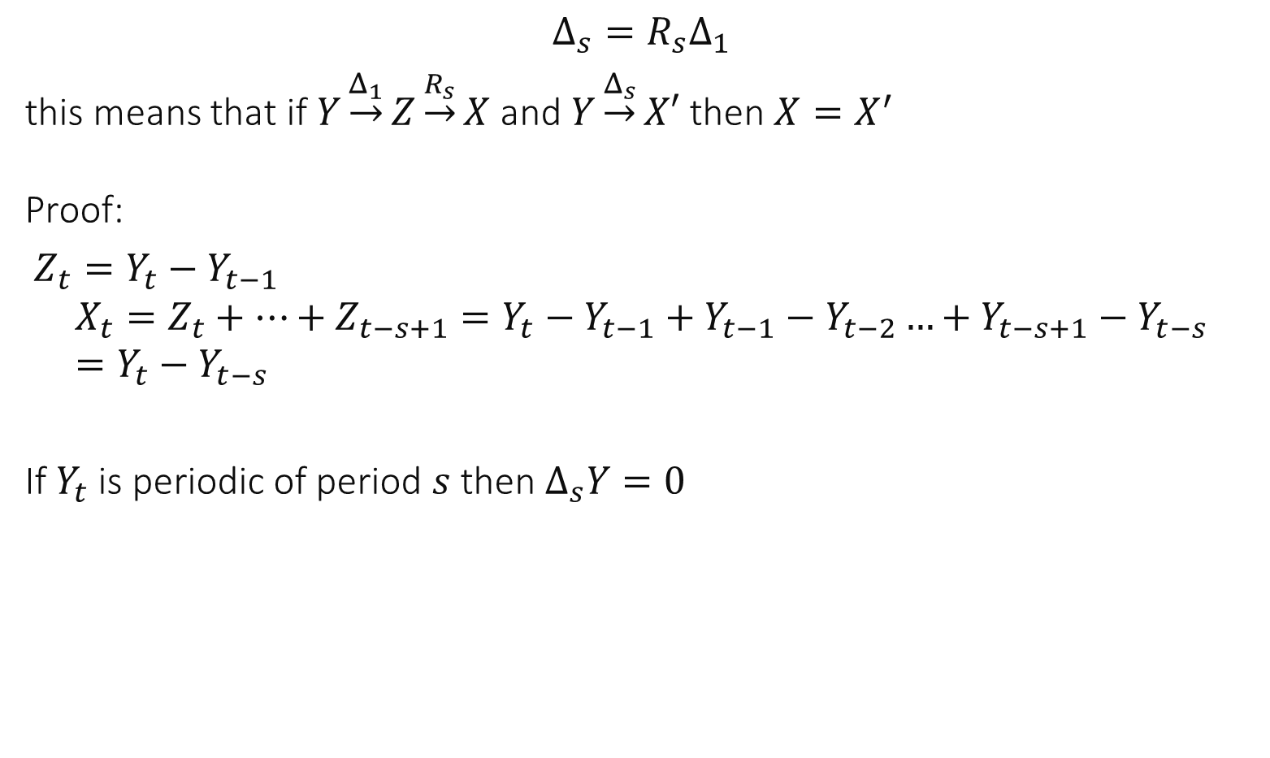
De-seasonalizing filters
$$Δ_{s}=R_{s}Δ_{1}$$ this means that if $Y\underset{→}{Δ_{1}}Z\underset{→}{R_{s}}X$ and $Y\underset{→}{Δ_{s}}X′$ then $X=X^{′}$ Proof:
$Z_{t}=Y_{t}−Y_{t−1}$ $$X_{t}=Z_{t}+…+Z_{t−s+1}=Y_{t}−Y_{t−1}+Y_{t−1}−Y_{t−2}…+Y_{t−s+1}−Y_{t−s}=Y_{t}−Y_{t−s}$$
If $Y_{t}$ is periodic of period $s$ then $Δ_{s}Y=0$

Slide 7
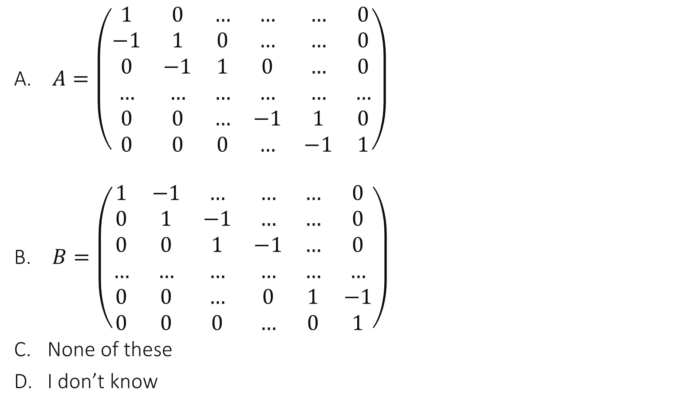

Which matrix is the representation of $Δ_{1}$ (over time series of length $n)$ ?
$A=\left(\begin{matrix}1 & 0 & … & … & … & 0 \\ −1 & 1 & 0 & … & … & 0 \\ 0 & −1 & 1 & 0 & … & 0 \\ … & … & … & … & … & … \\ 0 & 0 & … & −1 & 1 & 0 \\ 0 & 0 & 0 & … & −1 & 1\end{matrix}\right)$
$B=\left(\begin{matrix}1 & −1 & … & … & … & 0 \\ 0 & 1 & −1 & … & … & 0 \\ 0 & 0 & 1 & −1 & … & 0 \\ … & … & … & … & … & … \\ 0 & 0 & … & 0 & 1 & −1 \\ 0 & 0 & 0 & … & 0 & 1\end{matrix}\right)$
None of these
I don’t know

Slide 8
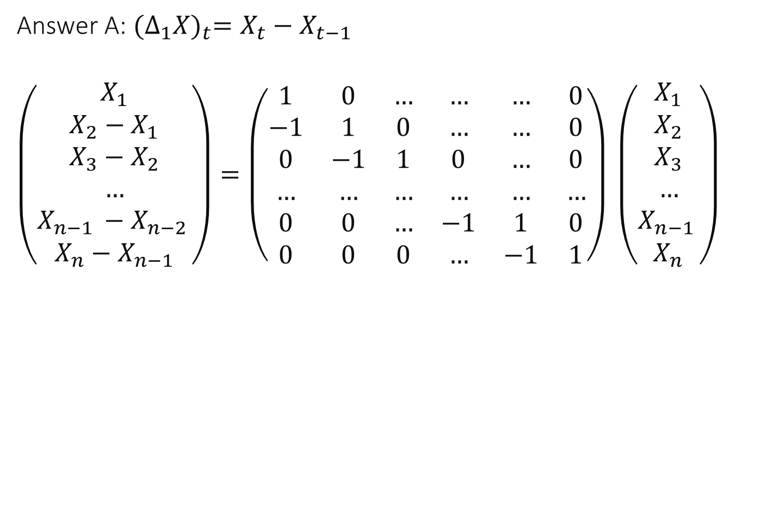
Answer A: ${(Δ_{1}X)}_{t}=X_{t}−X_{t−1}$
$\left(\begin{matrix}X_{1} \\ \begin{aligned}X_{2}−X_{1} \\ X_{3}−X_{2} \\ … \\ X_{n−1 }−X_{n−2 } \\ X_{n}−X_{n−1}\end{aligned}\end{matrix}\right)=\left(\begin{matrix}1 & 0 & … & … & … & 0 \\ −1 & 1 & 0 & … & … & 0 \\ 0 & −1 & 1 & 0 & … & 0 \\ … & … & … & … & … & … \\ 0 & 0 & … & −1 & 1 & 0 \\ 0 & 0 & 0 & … & −1 & 1\end{matrix}\right) \left(\begin{matrix}X_{1} \\ \begin{aligned}X_{2} \\ X_{3} \\ … \\ X_{n−1 } \\ X_{n}\end{aligned}\end{matrix}\right)$

Slide 9
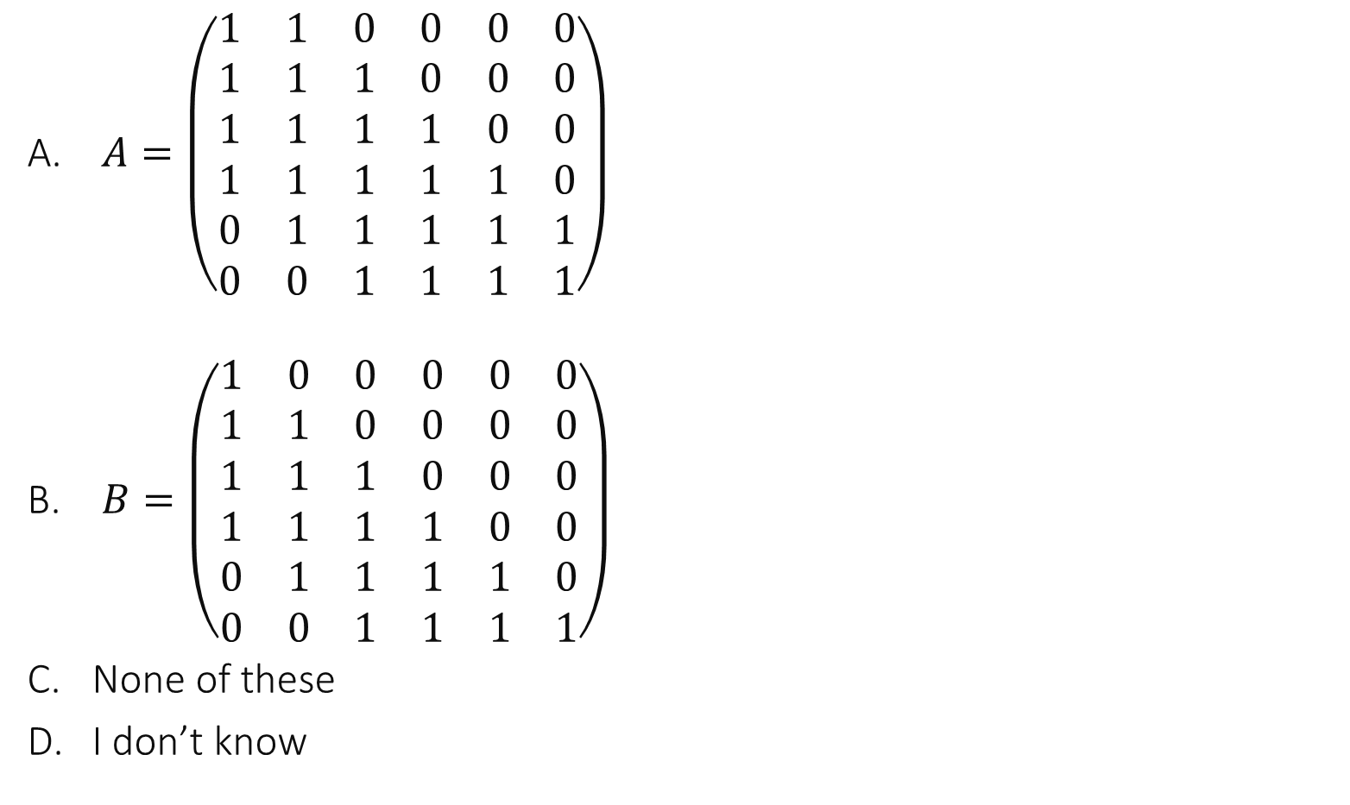

Which matrix is the representation of $R_{4}$ (over time series of length $n=6)$ ?
$A=\left(\begin{matrix}1 & 1 & 0 & 0 & 0 & 0 \\ 1 & 1 & 1 & 0 & 0 & 0 \\ 1 & 1 & 1 & 1 & 0 & 0 \\ 1 & 1 & 1 & 1 & 1 & 0 \\ 0 & 1 & 1 & 1 & 1 & 1 \\ 0 & 0 & 1 & 1 & 1 & 1\end{matrix}\right)$
$B=\left(\begin{matrix}1 & 0 & 0 & 0 & 0 & 0 \\ 1 & 1 & 0 & 0 & 0 & 0 \\ 1 & 1 & 1 & 0 & 0 & 0 \\ 1 & 1 & 1 & 1 & 0 & 0 \\ 0 & 1 & 1 & 1 & 1 & 0 \\ 0 & 0 & 1 & 1 & 1 & 1\end{matrix}\right)$
None of these
I don’t know

Slide 10
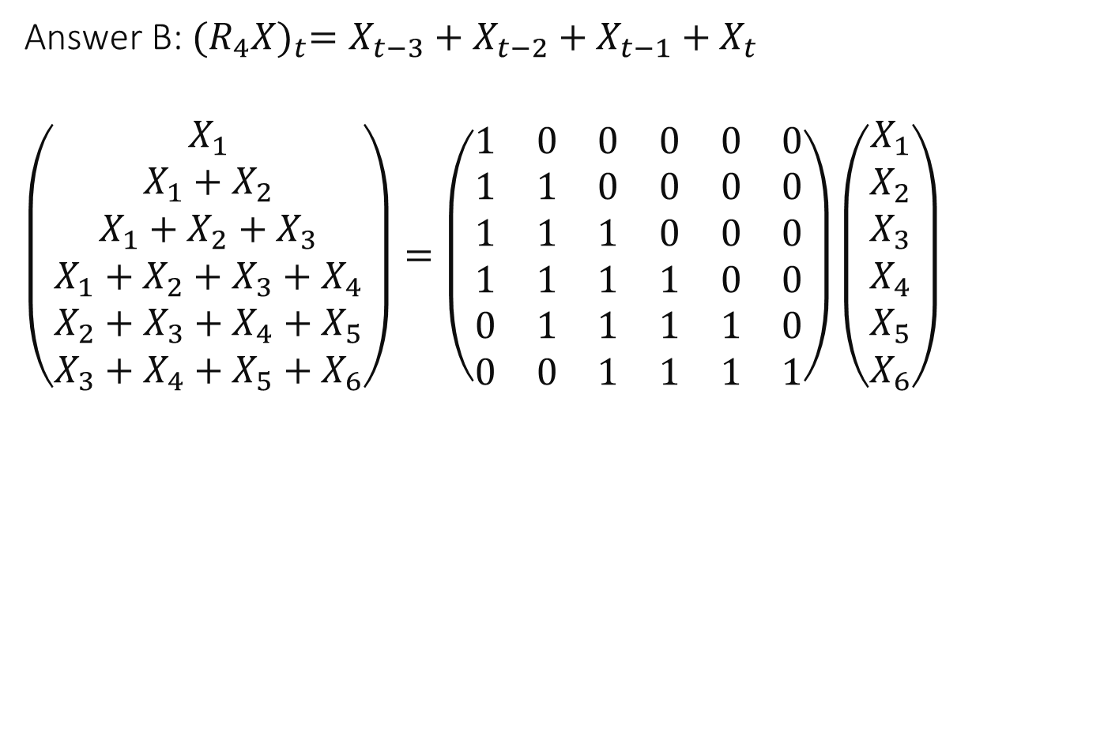
Answer B: ${(R_{4}X)}_{t}=X_{t−3}+X_{t−2}+X_{t−1}+X_{t}$
$\left(\begin{matrix}X_{1} \\ \begin{aligned}X_{1}+X_{2} \\ X_{1}+X_{2}+X_{3} \\ X_{1}+X_{2}+X_{3}+X_{4} \\ X_{2}+X_{3}+X_{4}+X_{5} \\ X_{3}+X_{4}+X_{5}+X_{6}\end{aligned}\end{matrix}\right)=\left(\begin{matrix}1 & 0 & 0 & 0 & 0 & 0 \\ 1 & 1 & 0 & 0 & 0 & 0 \\ 1 & 1 & 1 & 0 & 0 & 0 \\ 1 & 1 & 1 & 1 & 0 & 0 \\ 0 & 1 & 1 & 1 & 1 & 0 \\ 0 & 0 & 1 & 1 & 1 & 1\end{matrix}\right)\left(\begin{matrix}X_{1} \\ \begin{aligned}X_{2} \\ X_{3} \\ X_{4} \\ X_{5} \\ X_{6}\end{aligned}\end{matrix}\right)$

Slide 11
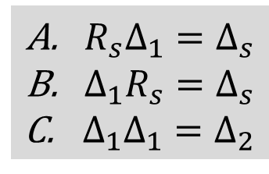
Say what is true
A
B
C
A,B
A,C
B,C
All
None
I don’t know
$R_{s}Δ_{1}=Δ_{s}$
$Δ_{1}R_{s}=Δ_{s}$
$Δ_{1}Δ_{1}=Δ_{2}$

Slide 12
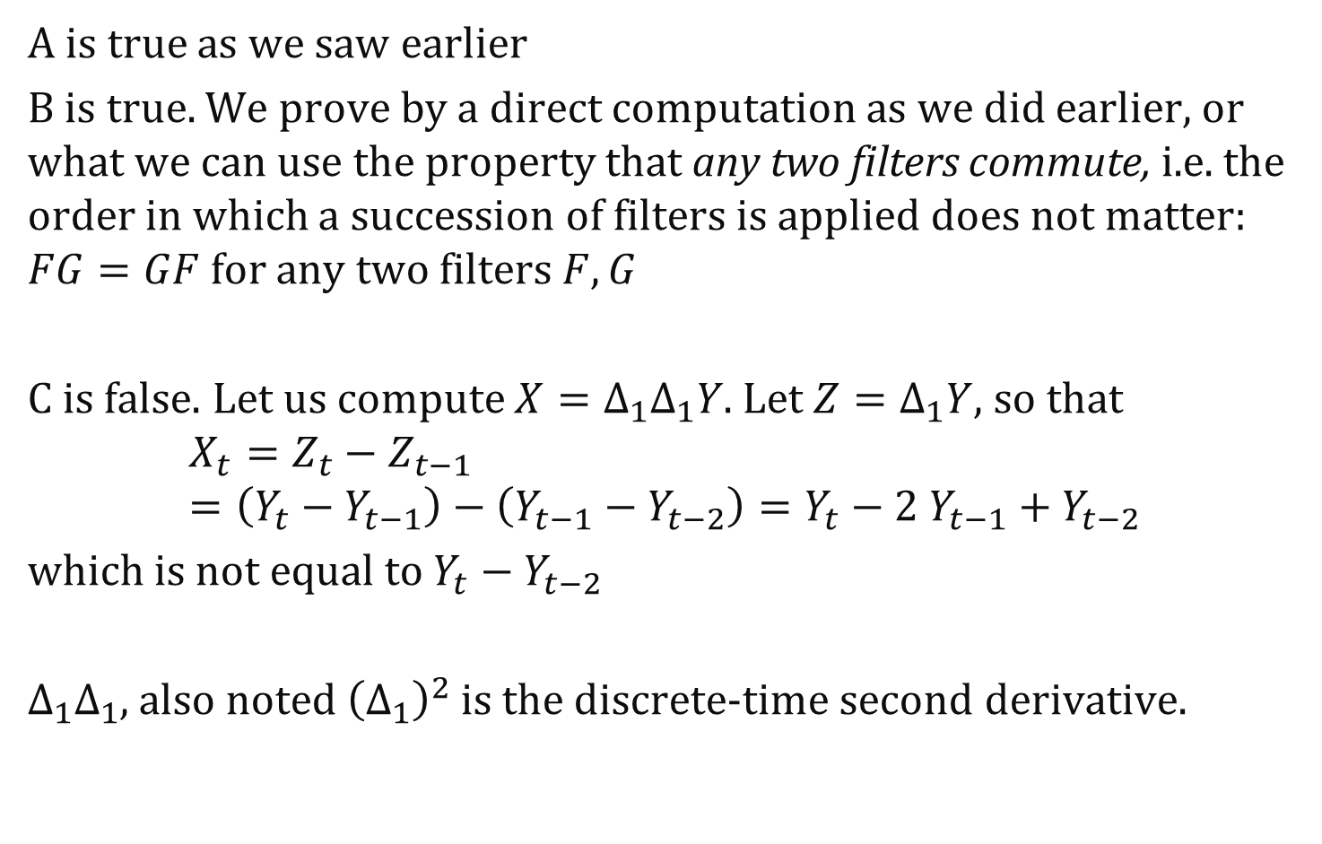
Solution
A is true as we saw earlier
B is true. We prove by a direct computation as we did earlier, or what we can use the property that any two filters commute, i.e. the order in which a succession of filters is applied does not matter: $FG=GF$ for any two filters $F,G$
C is false. Let us compute ${X=Δ}_{1}Δ_{1}Y$. Let $Z=Δ_{1}Y$, so that $$X_{t}=Z_{t}−Z_{t−1} \\ =\left(Y_{t}−Y_{t−1}\right)−\left(Y_{t−1}−Y_{t−2}\right)=Y_{t}−2 Y_{t−1}+Y_{t−2}$$
which is not equal to $Y_{t}−Y_{t−2 }$
$Δ_{1}Δ_{1}$, also noted ${\left(Δ_{1}\right)}^{2}$ is the discrete-time second derivative.

Slide 13
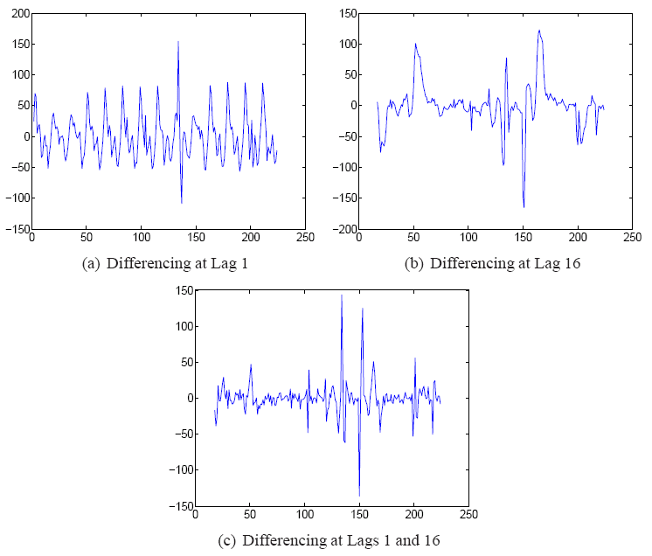
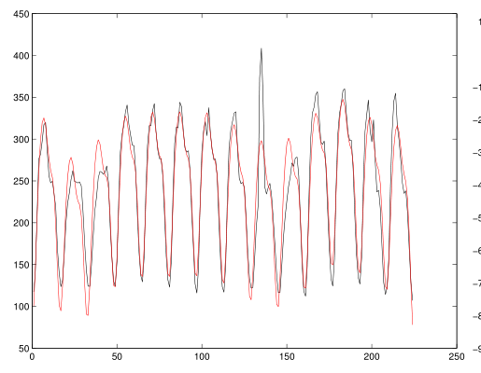

Slide 14
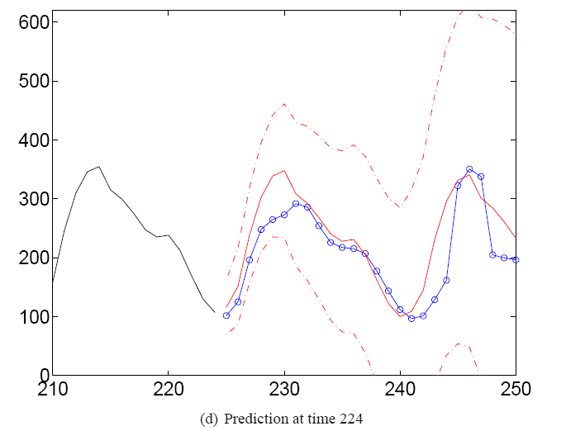
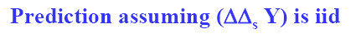
Point Predictions from Differenced Data
How are these predictions made ? To answer this question,we need to see how to use filters.

Slide 15
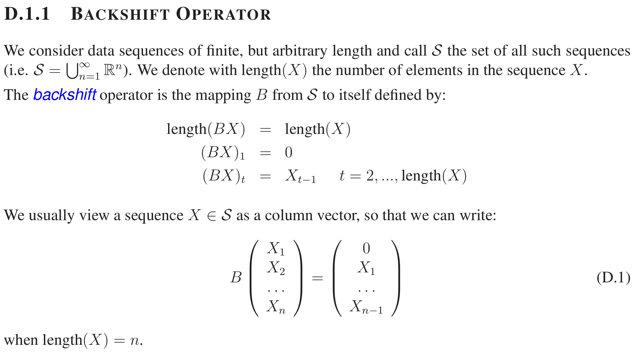
7. Filters for Dummies

Slide 16
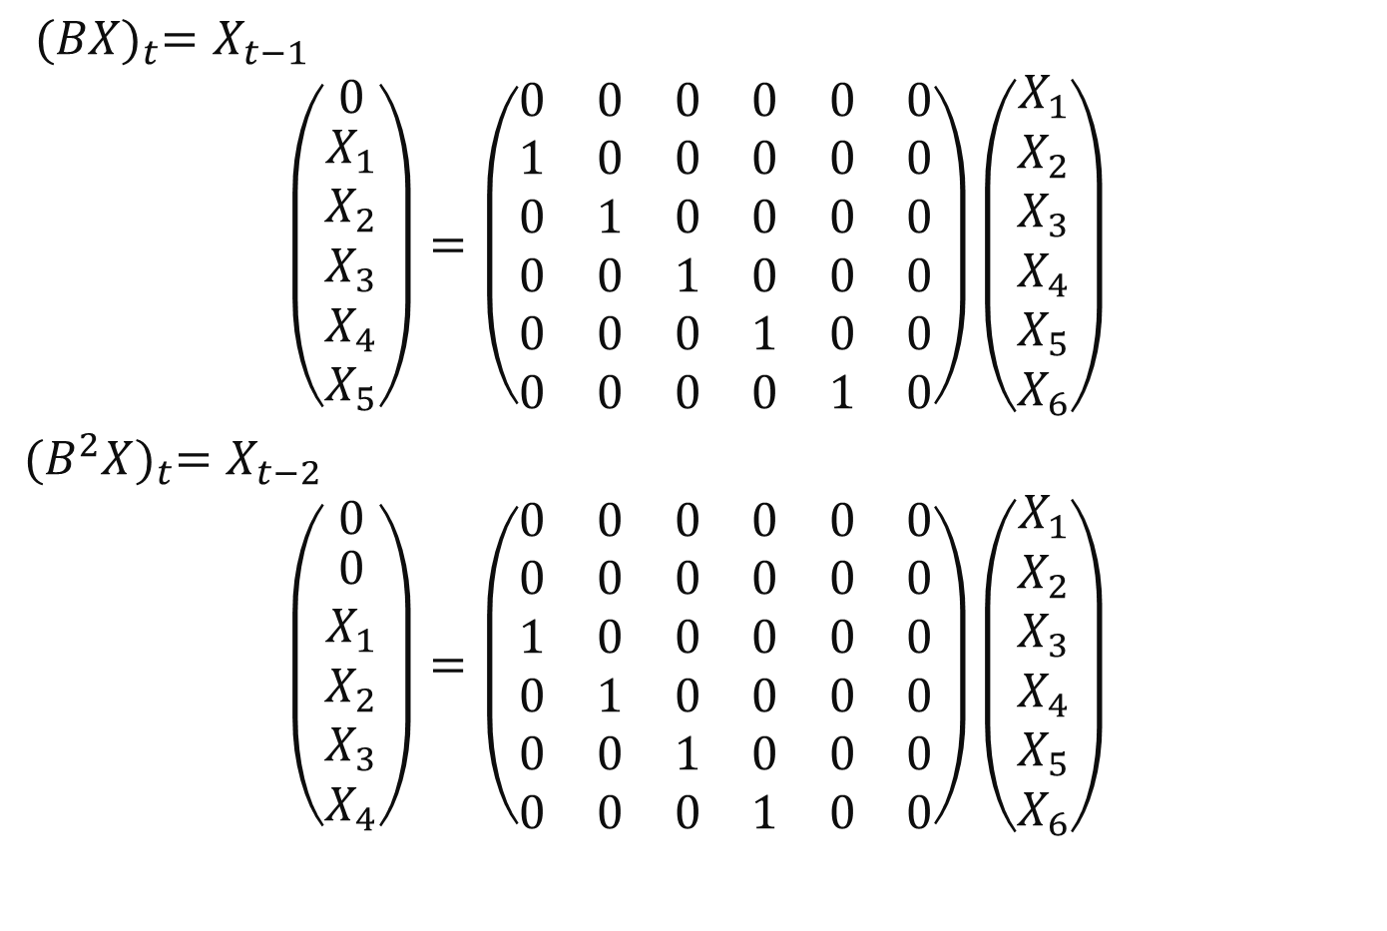


Backshift Operator in Matrix Form
${(BX)}_{t}=X_{t−1}$
$$\left(\begin{matrix}0 \\ \begin{aligned}X_{1} \\ X_{2} \\ X_{3} \\ X_{4} \\ X_{5}\end{aligned}\end{matrix}\right)=\left(\begin{matrix}0 & 0 & 0 & 0 & 0 & 0 \\ 1 & 0 & 0 & 0 & 0 & 0 \\ 0 & 1 & 0 & 0 & 0 & 0 \\ 0 & 0 & 1 & 0 & 0 & 0 \\ 0 & 0 & 0 & 1 & 0 & 0 \\ 0 & 0 & 0 & 0 & 1 & 0\end{matrix}\right)\left(\begin{matrix}X_{1} \\ \begin{aligned}X_{2} \\ X_{3} \\ X_{4} \\ X_{5} \\ X_{6}\end{aligned}\end{matrix}\right)$$
${(B^{2}X)}_{t}=X_{t−2}$
$$\left(\begin{matrix}0 \\ \begin{aligned}0 \\ X_{1} \\ X_{2} \\ X_{3} \\ X_{4}\end{aligned}\end{matrix}\right)=\left(\begin{matrix}0 & 0 & 0 & 0 & 0 & 0 \\ 0 & 0 & 0 & 0 & 0 & 0 \\ 1 & 0 & 0 & 0 & 0 & 0 \\ 0 & 1 & 0 & 0 & 0 & 0 \\ 0 & 0 & 1 & 0 & 0 & 0 \\ 0 & 0 & 0 & 1 & 0 & 0\end{matrix}\right)\left(\begin{matrix}X_{1} \\ \begin{aligned}X_{2} \\ X_{3} \\ X_{4} \\ X_{5} \\ X_{6}\end{aligned}\end{matrix}\right)$$

Slide 17
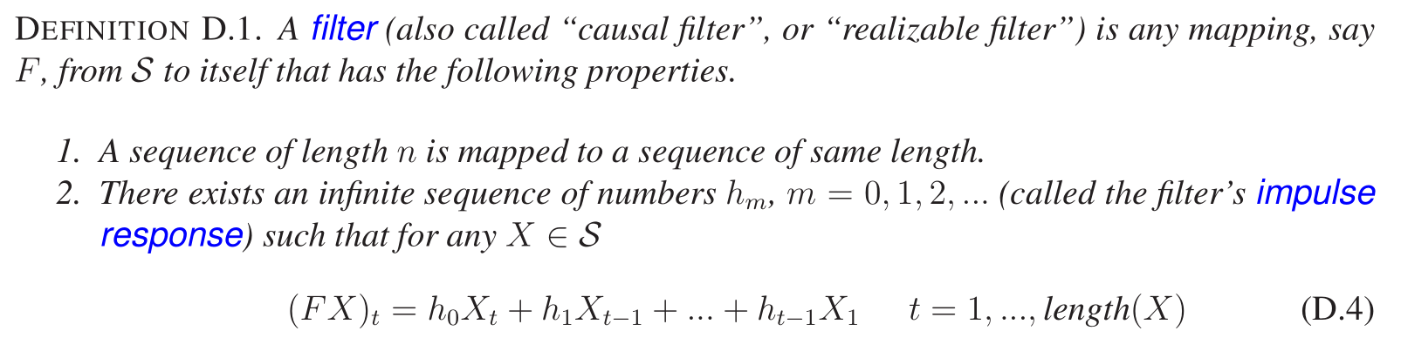
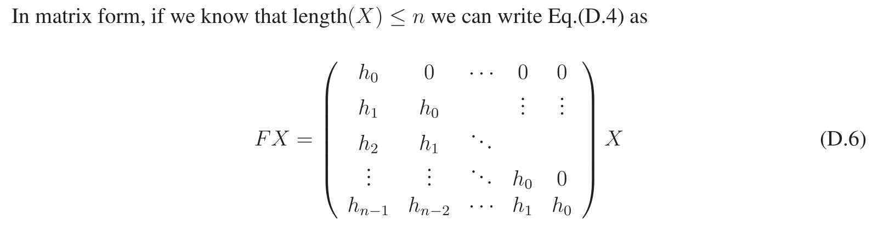
Filters for Dummies

Slide 18
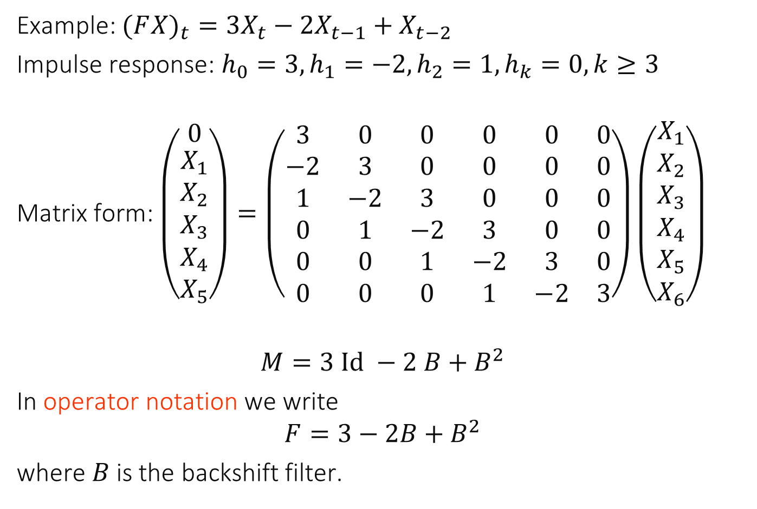
Operator Notation
Example: $(F{X)}_{t}={3X}_{t}−2X_{t−1}+X_{t−2}$
Impulse response: $h_{0}=3, h_{1}=−2, h_{2}=1, h_{k}=0, k≥3$
Matrix form: $\left(\begin{matrix}0 \\ \begin{aligned}X_{1} \\ X_{2} \\ X_{3} \\ X_{4} \\ X_{5}\end{aligned}\end{matrix}\right)=\left(\begin{matrix}3 & 0 & 0 & 0 & 0 & 0 \\ −2 & 3 & 0 & 0 & 0 & 0 \\ 1 & −2 & 3 & 0 & 0 & 0 \\ 0 & 1 & −2 & 3 & 0 & 0 \\ 0 & 0 & 1 & −2 & 3 & 0 \\ 0 & 0 & 0 & 1 & −2 & 3\end{matrix}\right)\left(\begin{matrix}X_{1} \\ \begin{aligned}X_{2} \\ X_{3} \\ X_{4} \\ X_{5} \\ X_{6}\end{aligned}\end{matrix}\right)$
$$M=3 Id −2 B+B^{2}$$
In operator notation we write
$$F=3−2B+B^{2}$$
where $B$ is the backshift filter.

Slide 19
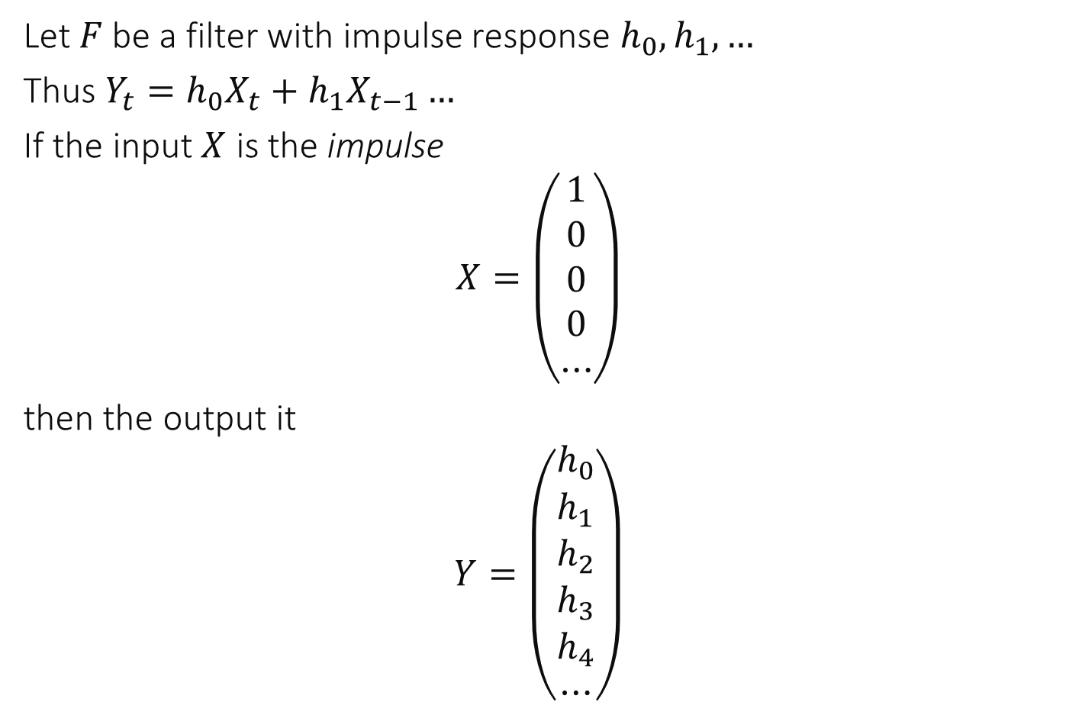
Impulse Response
Let $F$ be a filter with impulse response $h_{0},h_{1},…$
Thus $Y_{t}=h_{0}X_{t}+h_{1}X_{t−1}…$
If the input $X$ is the impulse
$$X=\left(\begin{aligned}1 \\ 0 \\ 0 \\ 0 \\ ⋯\end{aligned}\right)$$
then the output it
$$Y=\left(\begin{aligned}h_{0} \\ h_{1} \\ h_{2} \\ h_{3} \\ h_{4} \\ ⋯\end{aligned}\right)$$

Slide 20
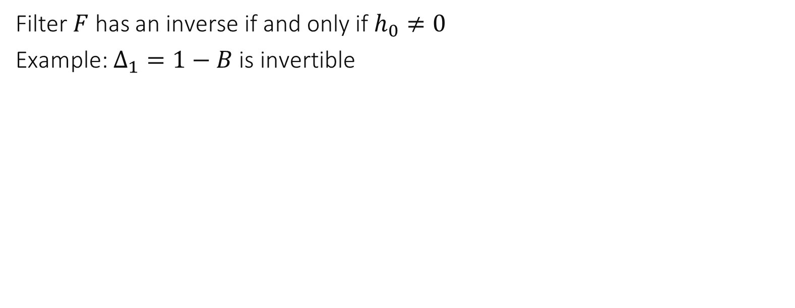
Inverse of a Filter
Filter $F$ has an inverse if and only if $h_{0}≠0$
Example: $Δ_{1}=1−B$ is invertible

Slide 21
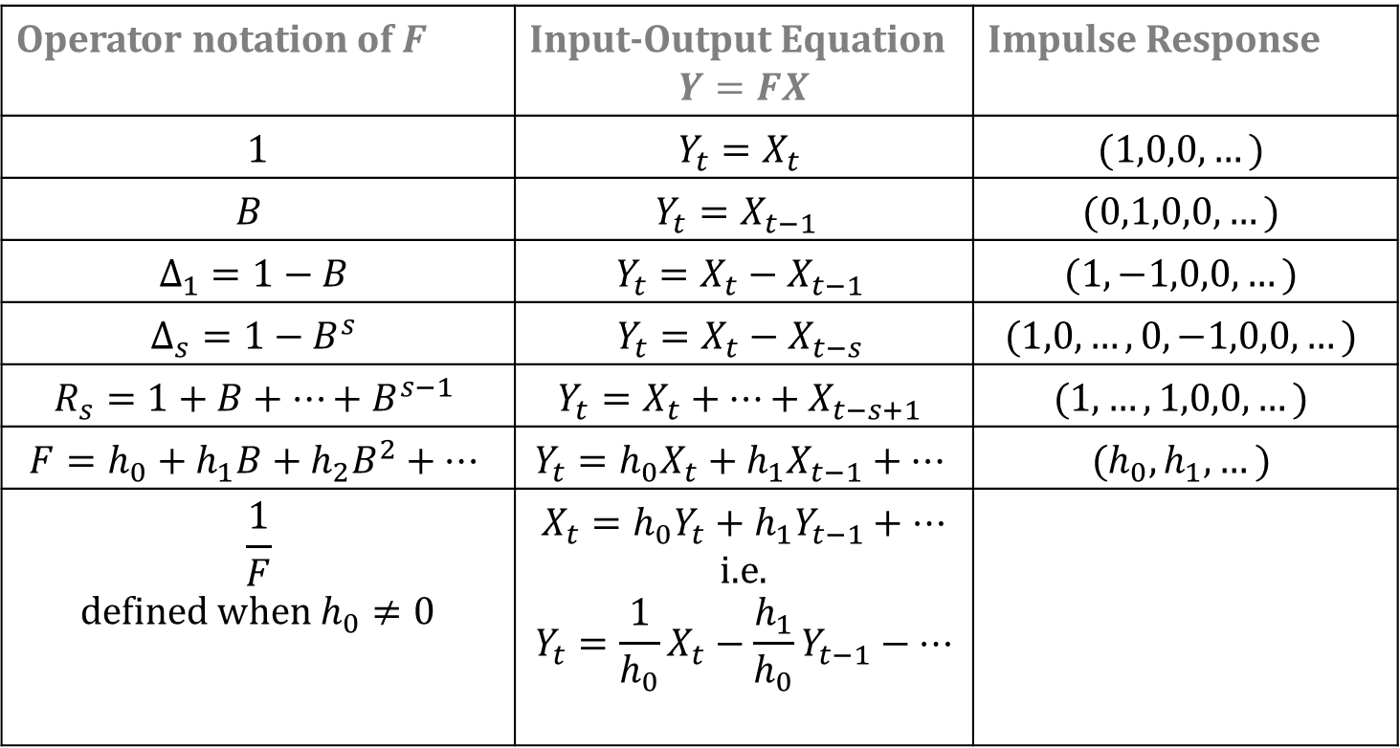
Filters
Operator notation of $F$ | Input-Output Equation $$Y=FX$$ | Impulse Response
1 | $$Y_{t}=X_{t}$$ | $$(1,0,0,…)$$
$$B$$ | $$Y_{t}=X_{t−1 }$$ | $$(0,1,0,0,…)$$
$$Δ_{1}=1−B$$ | $$Y_{t}=X_{t}−X_{t−1}$$ | $$(1,−1,0,0,…)$$
$$Δ_{s}=1−B^{s}$$ | $$Y_{t}=X_{t}−X_{t−s}$$ | $$(1,0,…,0,−1,0,0,…)$$
$$R_{s}=1+B+…+B^{s−1}$$ | $$Y_{t}=X_{t}+…+X_{t−s+1}$$ | $$(1,…,1,0,0,…)$$
$$F=h_{0}+h_{1}B+h_{2}B^{2}+…$$ | $$Y_{t}=h_{0}X_{t}+h_{1}X_{t−1}+…$$ | $$(h_{0},h_{1},…)$$
$$\frac{1}{F}$$ defined when $h_{0}≠0$ | $$X_{t}=h_{0}Y_{t}+h_{1}Y_{t−1}+…$$ i.e. $$Y_{t}=\frac{1}{h_{0}}X_{t}−\frac{h_{1}}{h_{0}}Y_{t−1}−…$$

Slide 22
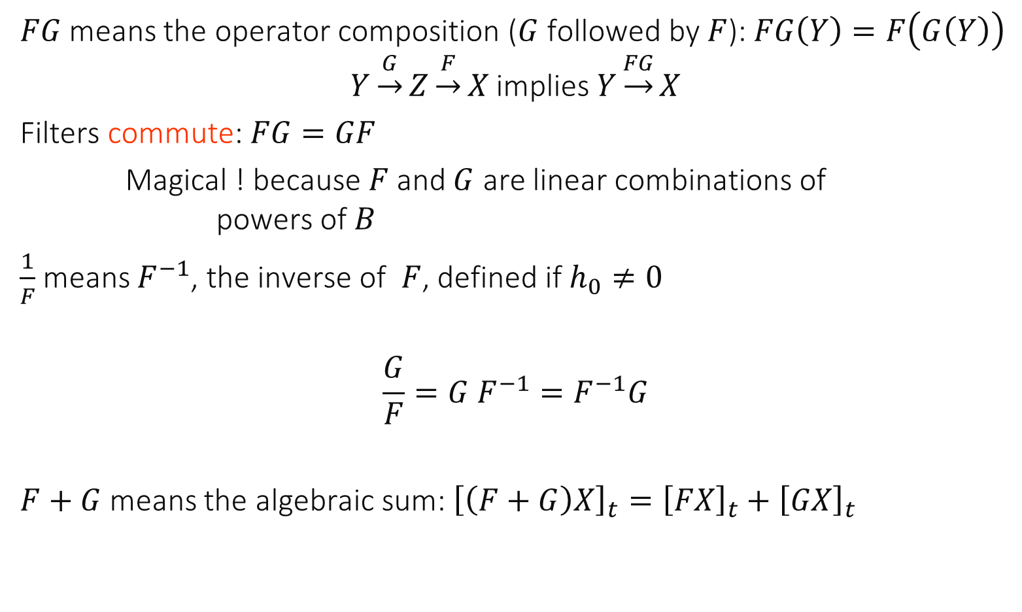
Calculus of Filters
$FG$ means the operator composition ($G$ followed by $F$): $FG\left(Y\right)=F\left(G\left(Y\right)\right)$
$$Y\underset{→}{G}Z\underset{→}{F}X \text{implies} Y\underset{→}{FG}X$$
Filters commute: $FG=GF$
Magical ! because $F$ and $G$ are linear combinations of powers of $B$
$\frac{1}{F}$ means $F^{−1}$, the inverse of $F$, defined if $h_{0}≠0$
$$\frac{G}{F}=G F^{−1}=F^{−1}G$$
$F+G$ means the algebraic sum: ${\left[\left(F+G\right)X\right]}_{t}={\left[FX\right]}_{t}+{\left[GX\right]}_{t}$

Slide 23
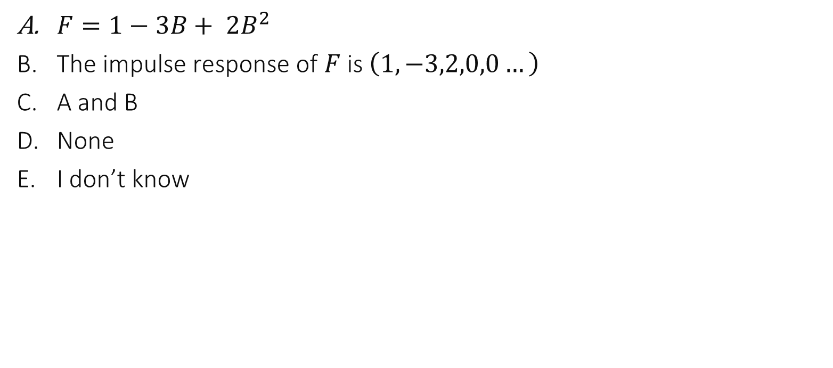
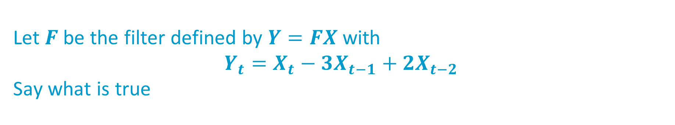
Let $F$ be the filter defined by $Y=FX$ with $$Y_{t}=X_{t}−3X_{t−1}+{2X}_{t−2}$$ Say what is true
$F=1−3B+ 2B^{2}$
The impulse response of $F$is $\left(1,−3,2,0,0…\right)$
A and B
None
I don’t know

Slide 24
Solution
Both A and B are true, by definition of filters

Slide 25
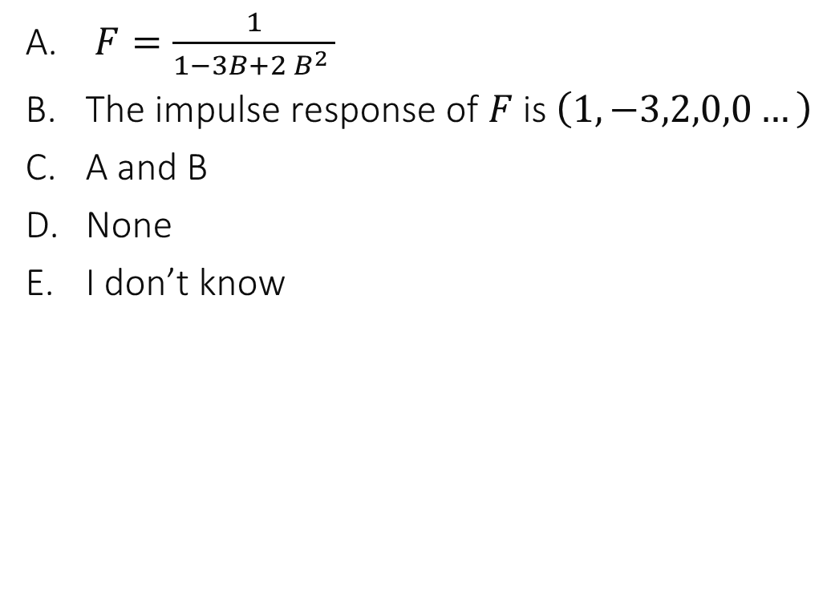
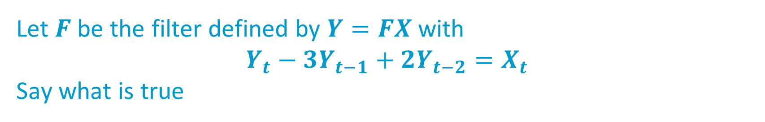
Let $F$ be the filter defined by $Y=FX$ with $$Y_{t}−3Y_{t−1}+2Y_{t−2}=X_{t}$$ Say what is true
$F=\frac{1}{1−3B+2 B^{2} }$
The impulse response of $F$is $\left(1,−3,2,0,0…\right)$
A and B
None
I don’t know

Slide 26
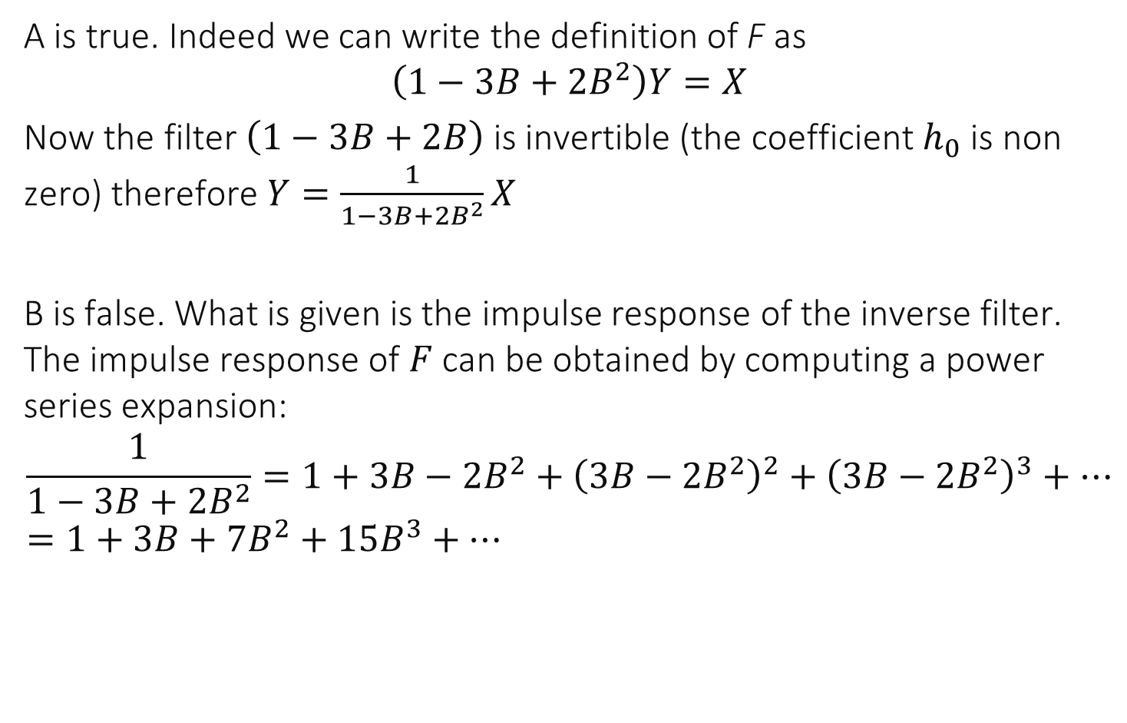
Solution
A is true. Indeed we can write the definition of F as
$$\left(1−3B+2B^{2}\right)Y=X$$
Now the filter $\left(1−3B+2B\right)$ is invertible (the coefficient $h_{0}$ is non zero) therefore $Y=\frac{1}{1−3B+2B^{2}}X$
B is false. What is given is the impulse response of the inverse filter. The impulse response of $F$ can be obtained by computing a power series expansion:
$$\frac{1}{1−3B+2B^{2}}=1+3B−2B^{2}+{\left(3B−2B^{2}\right)}^{2}+{\left(3B−2B^{2}\right)}^{3}+… \\ =1+3B+7B^{2}+15B^{3}+…$$

Slide 27
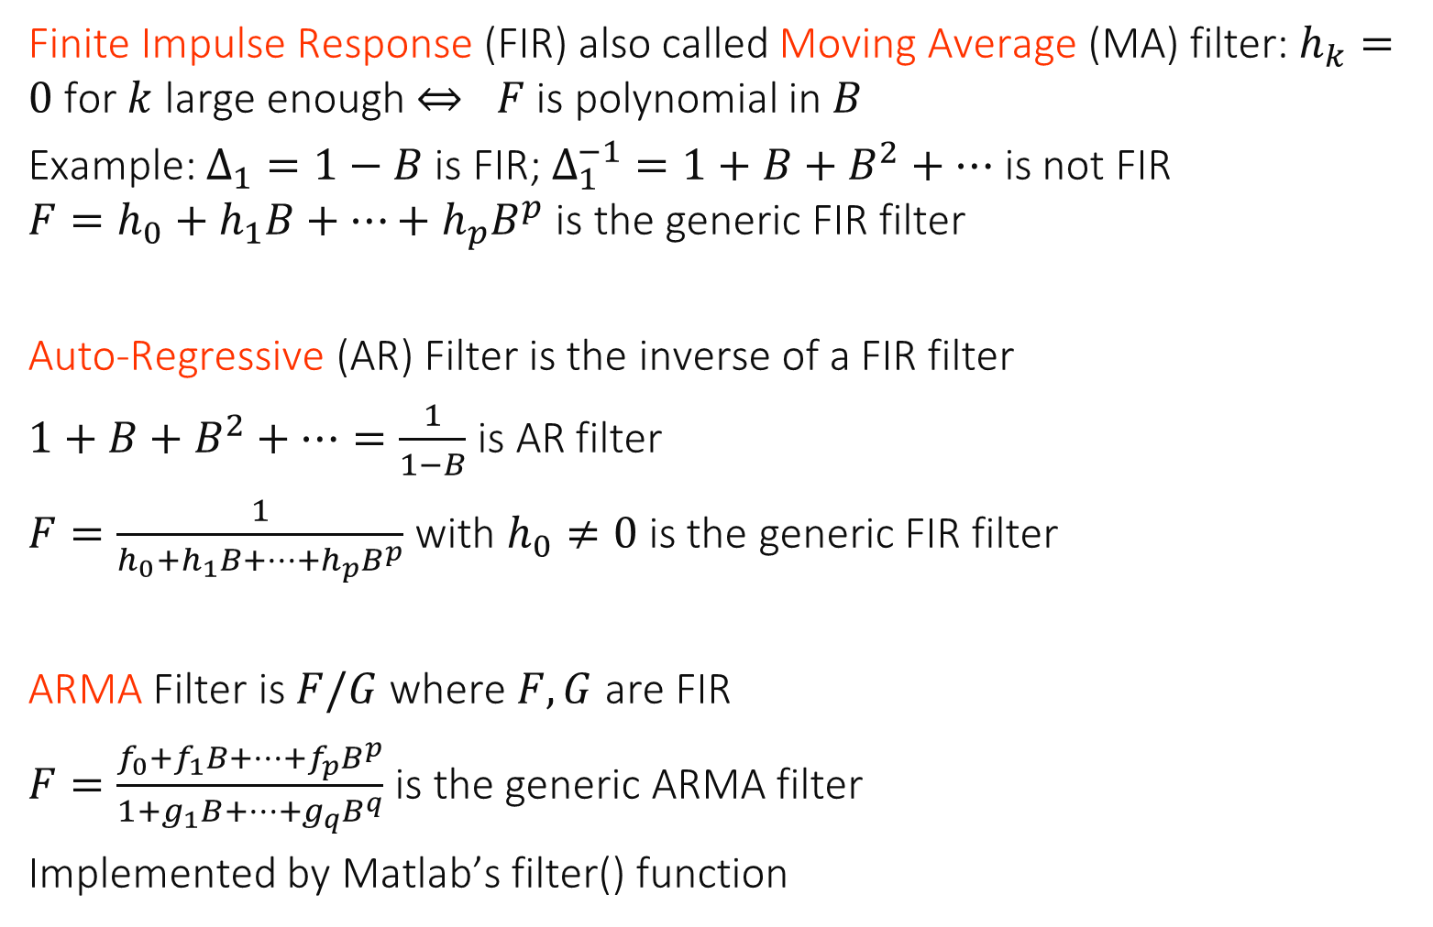
ARMA Filters and matlab’s filter function
Finite Impulse Response (FIR) also called Moving Average (MA) filter: $h_{k}=0$ for $k$ large enough $⇔ F$ is polynomial in $B$
Example: $Δ_{1}=1−B$ is FIR; $Δ_{1}^{−1}=1+B+B^{2}+…$ is not FIR $F=h_{0}+h_{1}B+…+h_{p}B^{p}$ is the generic FIR filter
Auto-Regressive (AR) Filter is the inverse of a FIR filter
$1+B+B^{2}+…=\frac{1}{1−B}$ is AR filter
$F=\frac{1}{h_{0}+h_{1}B+…+h_{p}B^{p}}$ with $h_{0}≠0$ is the generic FIR filter
ARMA Filter is $F/G$ where $F,G$ are FIR
$F=\frac{f_{0}+f_{1}B+…+f_{p}B^{p}}{1+g_{1}B+…+g_{q}B^{q}}$ is the generic ARMA filter
Implemented by Matlab’s filter() function

Slide 28
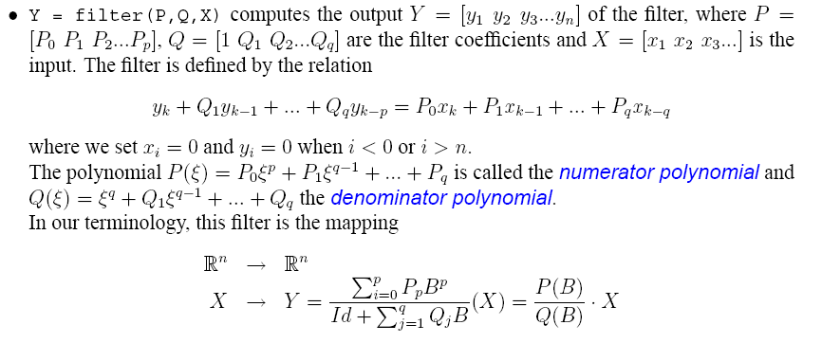
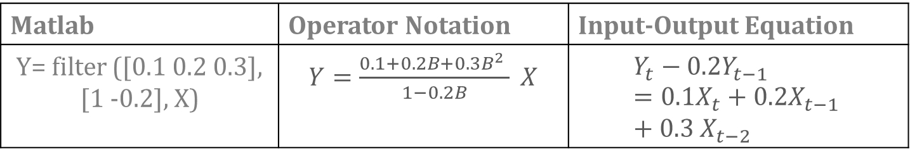
Matlab | Operator Notation | Input-Output Equation
Y= filter ([0.1 0.2 0.3], [1 -0.2], X) | $Y=\frac{0.1+0.2B+0.3B^{2} }{1−0.2B} X$ | $$Y_{t}−0.2Y_{t−1}=0.1X_{t}+0.2X_{t−1 }+0.3 X_{t−2}$$

Slide 29
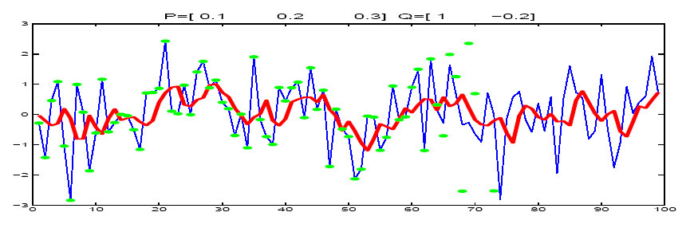
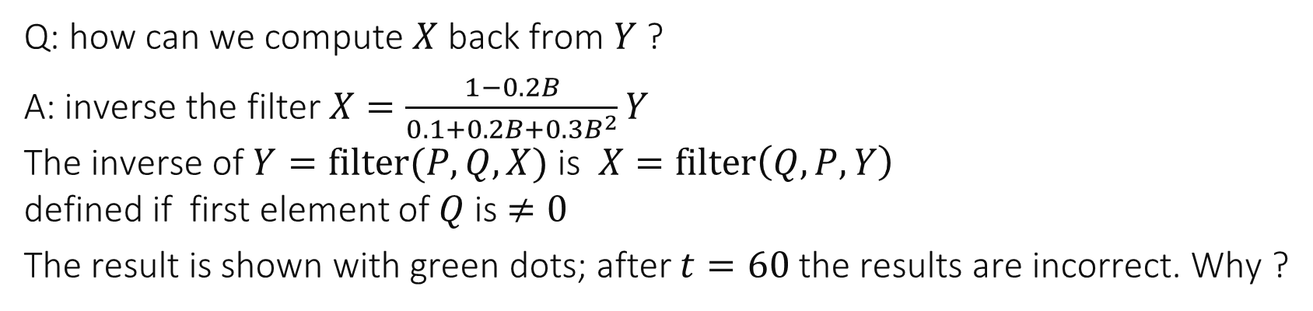
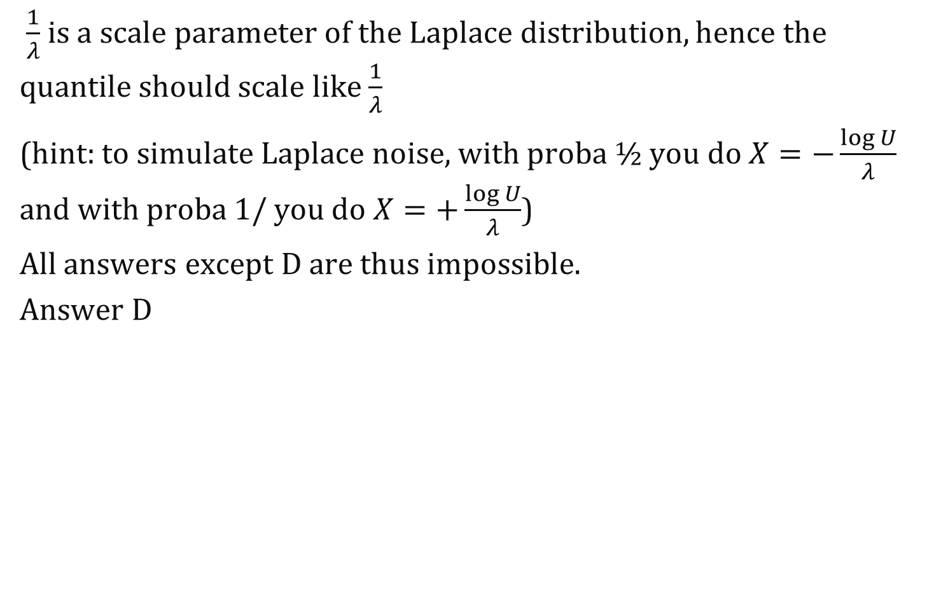
A sample of $Y=\frac{0.1+0.2B+0.3B^{2} }{1−0.2B} X$
X
Y
Q: how can we compute $X$ back from $Y$ ?
A: inverse the filter $X=\frac{1−0.2B}{0.1+0.2B+0.3B^{2}}Y$ The inverse of $Y=filter(P,Q,X)$ is $X=filter\left(Q,P,Y\right)$ defined if first element of $Q$ is $≠0$
The result is shown with green dots; after $t=60$ the results are incorrect. Why ?

Slide 30
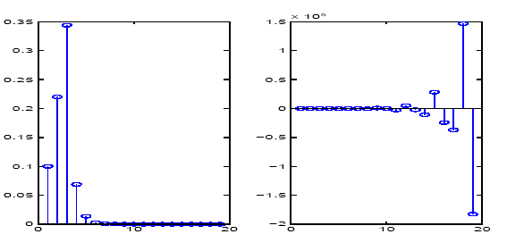
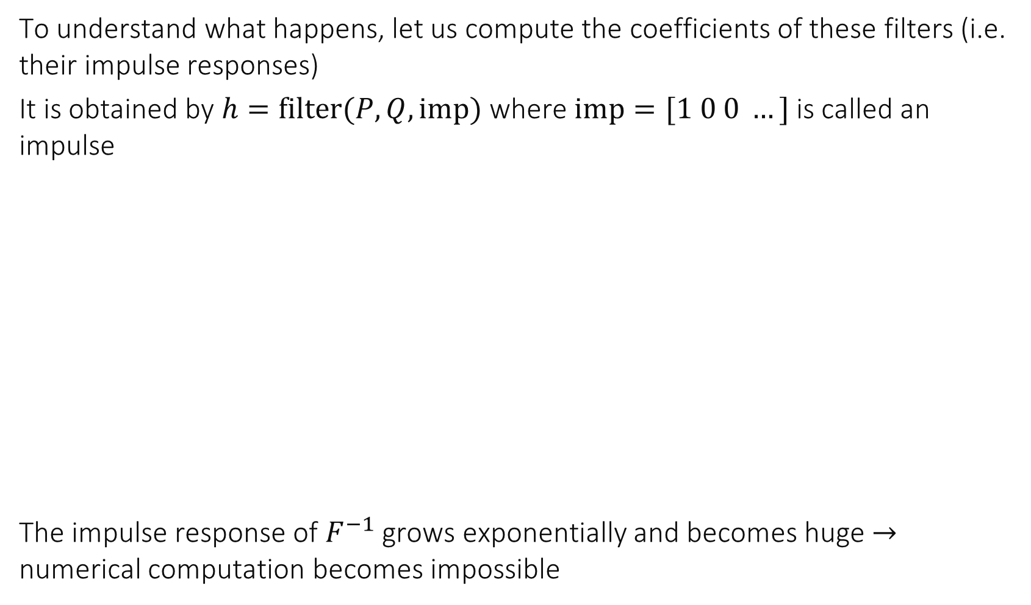
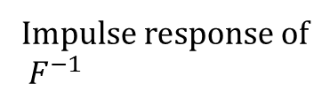
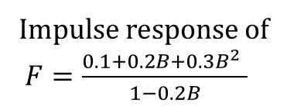
To understand what happens, let us compute the coefficients of these filters (i.e. their impulse responses)
It is obtained by $h=filter(P,Q, imp)$ where $imp=[1 0 0 …]$ is called an impulse
The impulse response of $F^{−1}$ grows exponentially and becomes huge $→$ numerical computation becomes impossible
Impulse response of $F=\frac{0.1+0.2B+0.3B^{2} }{1−0.2B}$
Impulse response of $F^{−1}$

Slide 31
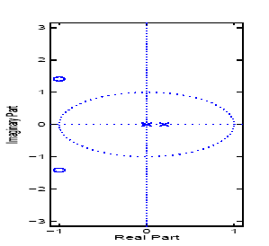
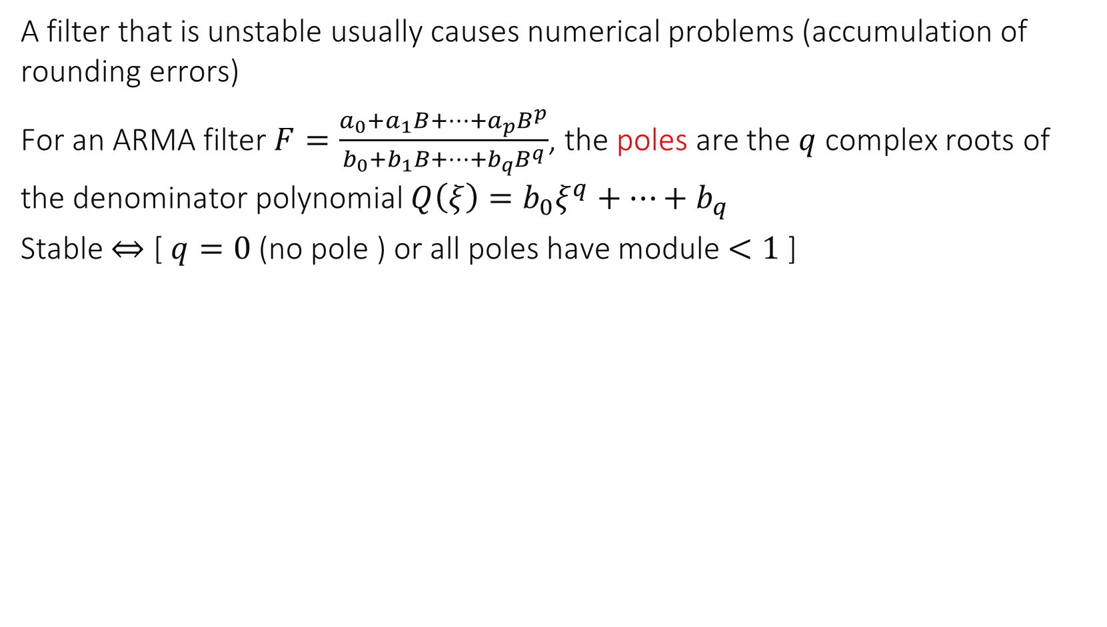

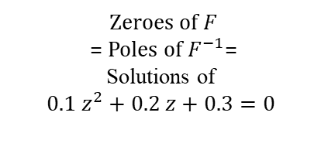
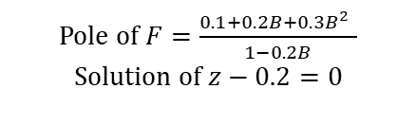
Filter BIBO Stability: $\sum_{n}{\left|h_{n}\right|<∞}$
A filter that is unstable usually causes numerical problems (accumulation of rounding errors)
For an ARMA filter $F=\frac{a_{0}+a_{1}B+…+a_{p}B^{p}}{b_{0}+b_{1}B+…+b_{q}B^{q}}$, the poles are the $q$ complex roots of the denominator polynomial $Q\left(ξ\right)=b_{0}ξ^{q}+…+b_{q}$
Stable $⇔$ [ $q=0$ (no pole ) or all poles have module $<1$ ]
zplane()
Zeroes of $F$
= Poles of $F^{−1}$= Solutions of $0.1 z^{2}+0.2 z+0.3=0$
Pole of $F=\frac{0.1+0.2B+0.3B^{2} }{1−0.2B}$
Solution of $z−0.2=0$

Slide 32
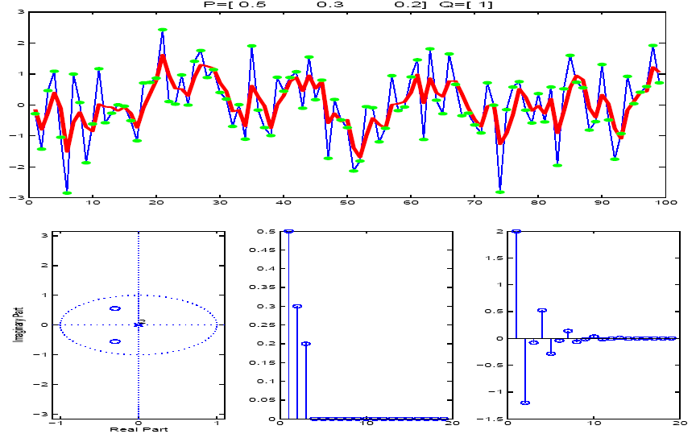
A filter with stable inverse
P=[0.5 0.3 0.2] Q=[1]

Slide 33
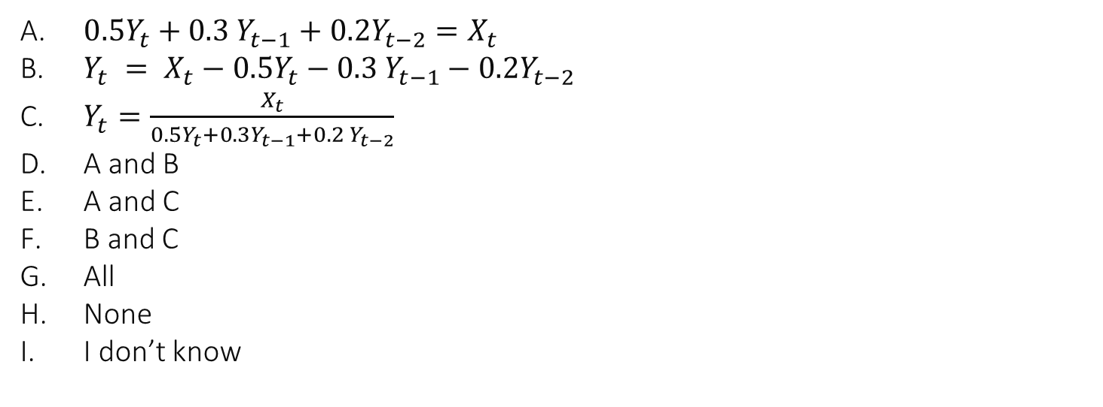
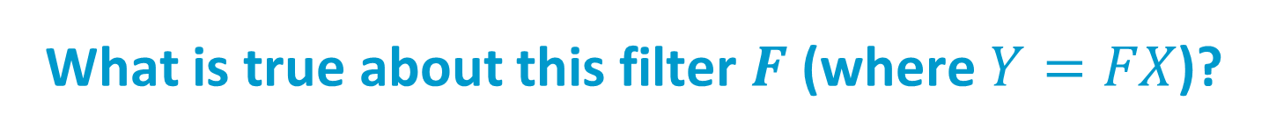
What is true about this filter $F$ (where $Y=FX$)?
P=[1] Q=[0.5 0.3 0.2]
$0.5Y_{t}+0.3 Y_{t−1}+0.2Y_{t−2}=X_{t}$
$Y_{t} = {X_{t}−0.5Y}_{t}−0.3 Y_{t−1}−0.2Y_{t−2}$
$Y_{t}=\frac{X_{t}}{0.5Y_{t}+0.3Y_{t−1}+0.2 Y_{t−2}}$
A and B
A and C
B and C
All
None
I don’t know

Slide 34
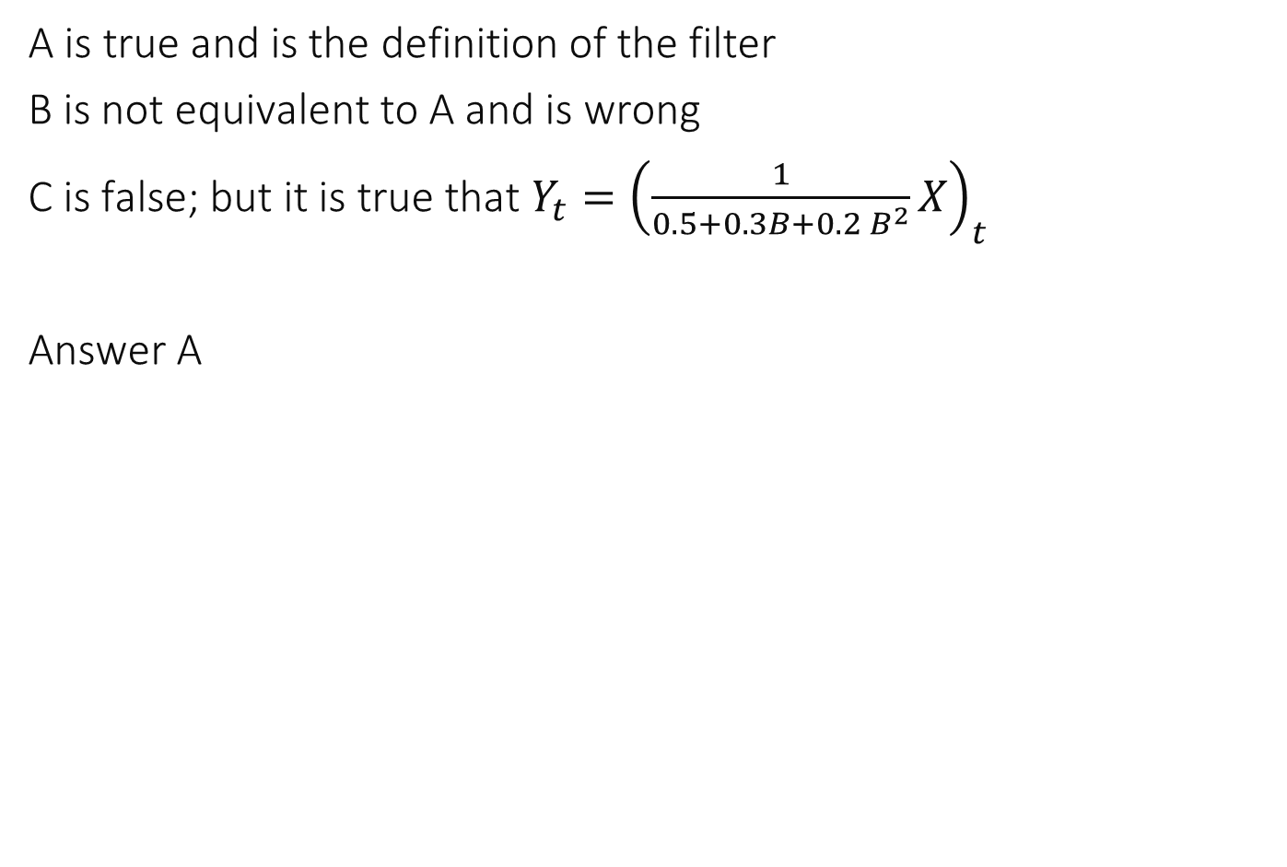
Solution
A is true and is the definition of the filter
B is not equivalent to A and is wrong
C is false; but it is true that $Y_{t}={\left(\frac{1}{0.5+0.3B+0.2 B^{2}}X\right)}_{t}$
Answer A

Slide 35
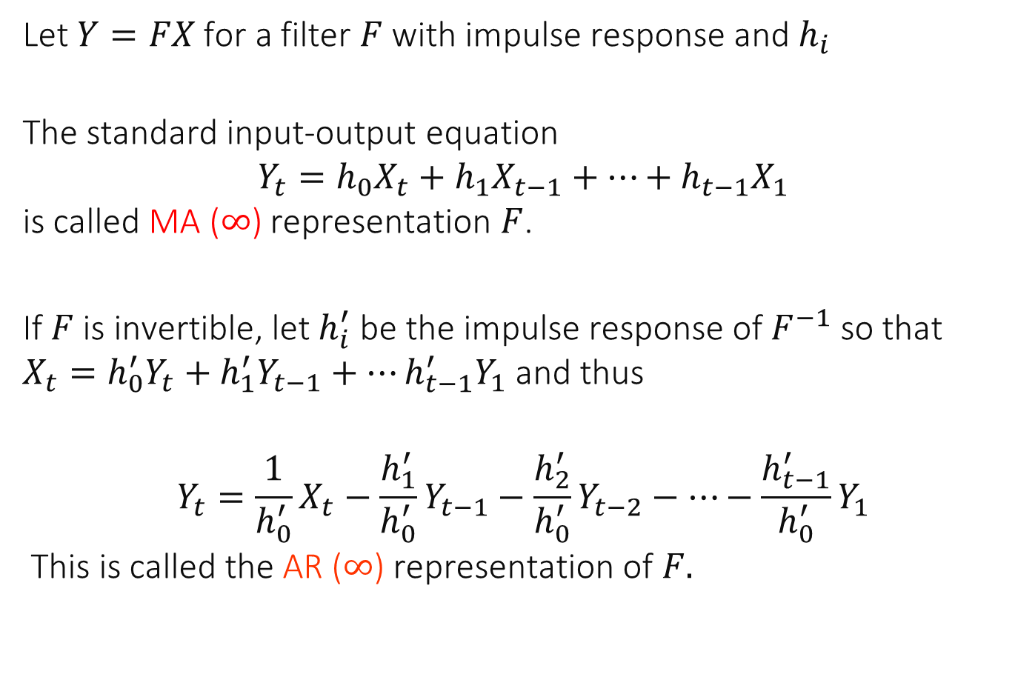
MA($∞$) and AR($∞$) representation of a filter $F$
Let $Y=FX$ for a filter $F$ with impulse response and $h_{i}$
The standard input-output equation $$Y_{t}=h_{0}X_{t}+h_{1}X_{t−1}+…+h_{t−1}X_{1}$$ is called MA ($∞$) representation $F$.
If $F$ is invertible, let $h_{i}^{′}$ be the impulse response of $F^{−1}$ so that $X_{t}=h_{0}^{′}Y_{t}+h_{1}^{′}Y_{t−1}+…h_{t−1}^{′}Y_{1}$ and thus
$$Y_{t}={\frac{1}{h_{0}^{′}}X}_{t}−\frac{h_{1}^{′}}{h_{0}^{′}}Y_{t−1}−\frac{h_{2}^{′}}{h_{0}^{′}}Y_{t−2}−…−\frac{h_{t−1}^{′}}{h_{0}^{′}}Y_{1}$$ This is called the AR ($∞$) representation of $F.$

Slide 36
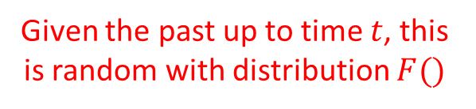

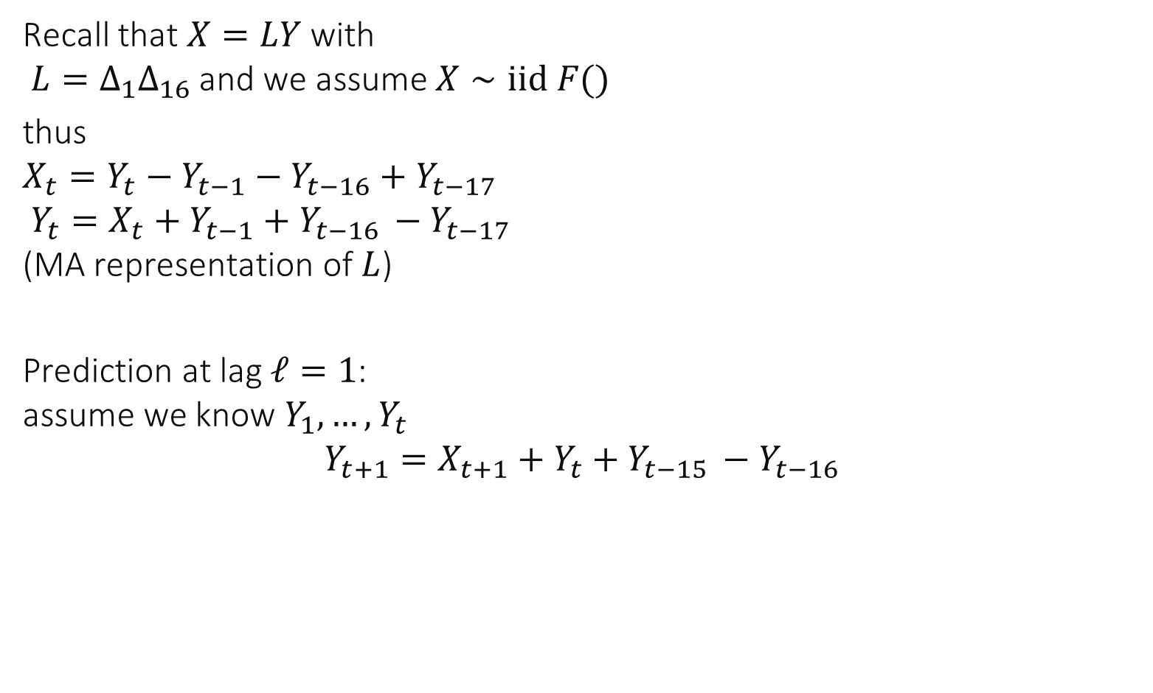



8. How is this prediction done ?
$$Y_{t}$$
Recall that $X=LY$with $L=Δ_{1}Δ_{16}$ and we assume $X∼iid F()$
thus $X_{t}=Y_{t}−Y_{t−1}−Y_{t−16}+Y_{t−17}$ $Y_{t}=X_{t}+Y_{t−1}+Y_{t−16 }−Y_{t−17}$ (MA representation of $L$)
Prediction at lag $ℓ=1$: assume we know $Y_{1},…,Y_{t}$ $$Y_{t+1}=X_{t+1}+Y_{t}+Y_{t−15 }−Y_{t−16}$$
$$X_{t}$$
known
Given the past up to time $t$, this is random with distribution $F()$

Slide 37


Point Prediction at lag 1
$$Y_{t}$$
Prediction at lag $ℓ=1$: assume we know $Y_{1},…,Y_{t}$ $$Y_{t+1}=X_{t+1}+Y_{t}+Y_{t−15 }−Y_{t−16}$$
Assume $X∼iid F()$ with zero mean, the mean of $Y_{t+1}$ given the past up to time $t$ is (point prediction) $${\hat{Y}}_{t}\left(1\right)=Y_{t}+Y_{t−15 }−Y_{t−16}$$
known
Given the past up to time $t$, this is random with distribution $F()$
$$X_{t}$$

Slide 38






Point Predictions
$$Y_{t}$$
Prediction at lag $ℓ=2$: assume we know $Y_{1},…,Y_{t}$ $$Y_{t+2}=X_{t+2}+Y_{t+1}+Y_{t−14 }−Y_{t−15}$$
Therefore : (point prediction at lag 2) ${\hat{Y}}_{t}\left(2\right)={\hat{Y}}_{t}(1)+Y_{t−14 }−Y_{t−15}$
At lag $ℓ$: use the formula $Y_{t+ℓ}=X_{t+ℓ}+Y_{t+ℓ−1}+Y_{t+ℓ−16}−Y_{t+ℓ−17}$ in which you replace $Y_{t+s}$ by ${\hat{Y}}_{t }(s)$ for $s>0$ and$X_{t+ℓ}$ by 0 (= the mean of $F()$)
for example ${\hat{Y}}_{t}\left(17\right)={\hat{Y}}_{t}\left(16\right)+{\hat{Y}}_{t}\left(1\right)−Y_{t}$
Given the past up to time $t$, the conditional expectation is 0 (F() has zero mean)
known
$$X_{t}$$
Given the past up to time $t$, the conditional expectation is ${\hat{Y}}_{t}(1)$

Slide 39


Slide 40




Use of the alternative representation (MA representation of $L^{−1})$
$$Y_{t}$$
Prediction at lag $ℓ=1$: assume we know $Y_{1},…,Y_{t}$ $Y_{t+1}=X_{t+1}+X_{t}+…+X_{t−14}$ $$+2\left(X_{t−15}+X_{t−16}+…+X_{t−30}\right) \\ +3\left(X_{t−31}+X_{t−32}+…+X_{t−46}\right)+…$$ therefore ${\hat{Y}}_{t}\left(1\right)=X_{t}+…+X_{t−14} +2\left(X_{t−15}+X_{t−16}+…+X_{t−30}\right) +3\left(X_{t−31}+X_{t−32}+…+X_{t−46}\right)+…$
Note it would not be a good idea to use this formula to compute ${\hat{Y}}_{t}\left(1\right)$ because we accumulate a large number of errors – but it can be used to compute prediction intervals
known
Given the past up to time $t$, this is random with distribution $F()$

Slide 41




Computation of Prediction Intervals (example with $ℓ=3)$
Prediction at lag $ℓ=3$: assume we know $Y_{1},…,Y_{t}$ Since the filter L is causal and invertible, knowing $Y_{1},…,Y_{t}$ is equivalent to knowing $X_{1},…,X_{t}$
$Y_{t+3}=X_{t+3}+X_{t+2}+X_{t+1}+X_{t}+…+X_{t−12}$ $$+2\left(X_{t−13}+X_{t−14}+…+X_{t−28}\right) \\ +3\left(X_{t−39}+X_{t−30}+…+X_{t−44}\right)+…$$
Therefore (innovation formula): $$Y_{t+3}=X_{t+3}+X_{t+2}+X_{t+1}+{\hat{Y}}_{t}(3)$$
Known at time $t$ $$={\hat{Y}}_{t}(3)$$

Slide 42

$Y_{t+3}=X_{t+3}+X_{t+2}+X_{t+1}+{\hat{Y}}_{t}\left(3\right)$ Given the past up to time $t$, the distribution of $Y_{t+3}$ is given by - a constant ${\hat{Y}}_{t}\left(3\right)$ - plus the sum of 3 independent random variables each with distribution $F()$ (the assumed distribution of $X_{t})$
Example: assume $X_{t}∼iid N\left(0,σ^{2}\right)$ the distribution of $X_{t+3}+X_{t+2}+X_{t+1}$ is $N(0,{3σ}^{2})$
i.e. the distribution of $Y_{t+3}$ given the past up to time $t$ is normal with mean ${\hat{Y}}_{t}\left(3\right)$ and variance $3 σ^{2}$

Slide 43

A 95%-prediction interval at lag 3 is…
$Y_{t}(3) ±1.96 σ$
${\hat{Y}}_{t}\left(3\right)±1.96×\sqrt{3} σ$
${\hat{Y}}_{t}\left(3\right)±1.96×3 σ$
${\hat{Y}}_{t}\left(3\right)±1.96×3\frac{σ}{\sqrt{n}}$
None of the above

Slide 44

Solution
The distribution of $Y_{t+3}$ given the past up to time $t$ is normal with mean ${\hat{Y}}_{t}\left(3\right)$ and variance $3 σ^{2}$, therefore with proba 95%, $Y_{t+3}$is in the interval ${\hat{Y}}_{t}\left(3\right)±1.96×\sqrt{3} σ$
Answer B

Slide 45

Prediction assuming differenced data is $iid N(0,σ^{2})$

Slide 46


Slide 47

Compare the Two
Linear Regression with 3 parameters + variance
Assuming differenced data is iid

Slide 48

9. Using ARMA Models for the Noise
This technique is used when the differenced data appears stationary but not iid – the correlation structure can be used to gain some information about futures
The differenced data can be modelled as an ARMA process instead of iid

Slide 49


Deciding whether a stationary $X_{t}$ is iid
Assume differenced time series$X_{t}$ looks stationary
Sample auto-covariance ${\hat{γ}}_{t}=\sum_{s=1}^{n−t}{(X_{t+s}−\overline{X})(X_{s}−\overline{X})}$
Sample Auto-Correlation Function (ACF) $ρ_{t}=\frac{{\hat{γ}}_{t}}{{\hat{γ}}_{0}}$
If $n$ is large and $X_{t}$ is iid, around 95% of the the values of ACF lie within $±\frac{1.96}{\sqrt{n}}$
See also tests (Ljung-Box test)

Slide 50






$$X_{t}$$
$$Y_{t}$$
$$±\frac{1.96}{\sqrt{n}}$$

Slide 51


ARMA Process

Slide 52

ARMA Process
In other words, the random sequence $X_{t}$ is an ARMA process with mean $μ$ iff
$$X=μ+Fε$$
with $F=\frac{1+C_{1}B+…C_{q}B^{q}}{1+A_{1}B+…+A_{p}B^{p}}$ we require that $F$ and $\frac{1}{F}$ are stable.
i.i.d. sequence
ARMA filter
constant

Slide 53

Examples of ARMA processes

Slide 54

Which of these matlab scripts produce a sample $X$of an ARMA process ?
X=filter([1 ; -0.4],[1;0.4],randn(1,n))
X=filter([1 ; 0.4],[1;-0.4],randn(1,n))
A and B
None
I don’t know

Slide 55

Solution
A and B each produce a sample of $F(ε)$ where $ε$ is an iid sequence of $n$ standard normal random variables and $F$ is an ARMA filter.
We need to verify whether the filter and its inverse are stables. For A, the roots of the numerator polynomial are $z−0.4=0,$thus $z=0.4$; for the denominator polynomial we have $z+0.4=0$ thus $z=−0.4$ thus both $F$ and $F^{−1}$ are stable.
Idem for B.
Both A and B are ARMA processes.
Answer C

Slide 56

ARMA Processes are Gaussian (non iid)

Slide 57



Slide 58


Slide 59

ARIMA Process
$Y_{t}$ is called an ARIMA process if $X=LY$ is an ARMA process, where $L$ is a combination of differencing and deseasonalizing filters
How to fit an ARIMA process ?
Apply differencing filters until appears stationary
Fit the differenced process $X=LY$ using the ARMA fitting procedure (Thm 5.2, Matlab’s armax);
Check ACF of residuals; residuals are ${ε_{t}=X}_{t}−{\hat{X}}_{t−1}(1)$(innovation formula)
Be careful with overfitting problem – use AIC or BIC; ACF of $X$ may give an idea of order

Slide 60
Fitting an ARMA process is a non-linear optimization problem
Usually solved by iterative, heuristic algorithms, may converge to a local maximum may not converge
Some simple, non MLE, heuristics exist for AR or MA models
Ex: fit the AR model that has the same theoretical ACF as the sample ACF
Common practice is to bootstrap the optimization procedure by starting with a “best guess”
AR or MA fit, using heuristic above

Slide 61


Example

Slide 62


Slide 63







$$X=L Y$$
Stationary but not iid
$$ε=F^{−1}X$$
iid
$$Y$$

Slide 64




Forecasting with an ARIMA Process $Y_{t}$
By composition of filters, $Y=L^{− 1}X=L^{−1}Fε$ where $F$ is the filter of the ARMA process and $L$ is the differencing filter. Using the impulse response of $L^{−1}F$ and its inverse we obtain formulas similar to those we saw previously. See Prop 5.4.
with ARMA model for filtered data $X=LY$
assuming filtered data 𝑋=𝐿𝑌 is iid gaussian

Slide 65

Algorithmic Deltails: Classical ARIMA modeling
Recall: original data $Y_{t}$, remove trends and seasonality: $X=LY$ and model $X$ as ARMA process: $X=Fε$ ($F$ is an ARMA filter - $F, F^{−1}$ stable) where $ε$ appears iid (and often with zero mean)
Point forecasts: $ε=F^{−1}LY$ use the (fast decaying) impulse response $h$ of $F^{−1}L$ ($h_{0}=1$) $$Y_{t+ℓ}=ε_{t+ℓ}−h_{1}Y_{t+ℓ−1}−h_{2}Y_{t+ℓ−2} − …−h_{t+ℓ−1}Y_{1}$$ e.g. $Y_{t+1}=ε_{t+1}−h_{1}Y_{t}−h_{2}Y_{t−1} −…$ and $Y_{t+2}=ε_{t+2}−h_{1}Y_{t+1}−h_{2}Y_{t} −h_{3}Y_{t−1} …$ thus ${\hat{Y}}_{t}\left(1\right)=−h_{1}Y_{t}−h_{2}Y_{t−1}−…−h_{t}Y_{1}$ ${\hat{Y}}_{t}\left(2\right)=−h_{1}{\hat{Y}}_{t}\left(1\right)−h_{2}Y_{t}− …−h_{t+1}Y_{1}$
Forecast intervals: $Y=L^{−1}Fε$ use the (slowly diverging) impulse response $d$ of $L^{−1}F$ ($d_{0}=1$): $Y_{t+ℓ}=ε_{t+ℓ}+d_{1}ε_{t+ℓ−1}+…{+d}_{ℓ−1}ε_{t+1}+…+d_{t+ℓ−1}ε_{1}$ and obtain the innovation formula
$$Y_{t+ℓ}=ε_{t+ℓ}+d_{1}ε_{t+ℓ−1}+…{+d}_{ℓ−1}ε_{t+1}+{\hat{Y}}_{t}\left(ℓ\right)$$ from where prediction intervals are derived e.g. if $ε_{t}∼N_{0,σ^{2}}$, then a 95% prediction interval is ${\hat{Y}}_{t}\left(ℓ\right)±1.96 σ \sqrt{1+d_{1}^{2}+…+d_{ℓ−1}^{2}}$

Slide 66

Improve Confidence Interval If Residuals are not Gaussian (but appear to be iid)
Assume residuals are not gaussian but are iid
How can we get prediction intervals ?
Bootstrap by sampling from residuals

Slide 67


Slide 68


With gaussian assumption
With bootstrap from residuals

Slide 69

Recap: ARIMA modeling
Given some data series $Y_{t}$
Remove trends and seasonality: $X=LY$ ($L$ is a product of differencing filters)
Model $X$ as ARMA process: $X=Fε$ ($F$ is an ARMA filter - $F, F^{−1}$ stable) to make $ε$ appear iid
If $ε$ appears gaussian use closed form formulae (Prop 5.4) for prediction intervals Else simulate $R$future trajectories by re-sampling from $ε$ with replacement and obtain prediction intervals

Slide 70
10. Other
We have seen a few forecasting methods
regression models
use of differencing filters to make noise stationary
use of ARMA models to make noise iid
use of bootstrap to estimate prediction intervals
We did no study
machine learning methods
These methods can be combined together
linear regression with ARMA noise
filter the data then apply clustering method or neural net

Slide 71

Linear Regression with ARMA Noise
Assume a linear regression model $Y_{t}=\sum_{i}{β_{i}}x_{t}^{i}+ε_{t}$ where we find that $ε_{t}$ does not look iid at all. We can model $ε_{t}$ as an ARMA process and obtain $Y_{t}=\sum_{i}{β_{i}}x_{t}^{i}+{Fw}_{t}$ where $F$ is an ARMA filter and$w_{t}$ is iid $N(0,σ^{2})$
Apply the inverse filter and obtain a linear regression model $${\left(F^{−1}Y\right)}_{t}=\sum_{i}{β_{i}}{\left(F^{−1}x^{i}\right)}_{t}+w_{t}, with w_{t} ∼ \text{iid} N(0,σ^{2})$$
If we know $F$ we can estimate $β$; if we know $β$ we can estimate $F$ $⇒$ iterate until it converges
Prediction formulae can be obtained using the calculus of filters exactly as we did above.

Slide 72
Sparse ARMA Models
Problem: avoid many parameters when the degree of the A and C polynomials (of ARMA model) are high
Based on heuristics
Multiplicative ARIMA, constrained ARIMA
Holt Winters
See section 5.6

Slide 73

Constrained ARIMA
Sparse models give less accurate predictions but have much fewer parameters and are simple to fit.

Slide 74
Conclusion
Forecasting is saying something about the conditional distribution of the the future given the past and present.
Classical methods use: model fitting (regression ), filters, ARMA noise models.
Information criteria can be used to avoid overfitting.

